Slide 1
10 Artificial Immune Systems
Ke-Lin Du and M.N.S. Swamy, Search and Optimization by Metaheuristics - Techniques and Algorithms Inspired by Nature, Springer, 2016

Slide 2
AISs are based on four main immunological theories
  clonal selection
  immune networks
  Negative selection
  danger theory
This chapter introduces four immune algorithms inspired by the four immunological theories.

Slide 3
10.1 Introduction
An Artificial Immune System (AIS) is inspired by the biological immune system, which protects the body by detecting and eliminating pathogens, tumor cells, and malfunctioning cells. The immune system distinguishes between self and nonself molecules and maintains diversity in its immune repertoire.

Slide 4
Vertebrate immune systems defend against viruses, bacteria, parasites, and fungi without prior knowledge of specific pathogens. Memory cells store information about previously encountered threats, enabling rapid responses to future infections. This adaptive, distributed, and self-organized nature makes the immune system a valuable model for computer science applications, such as intrusion detection systems.

Slide 5
The immune system consists of organs like the thymus, spleen, and lymph nodes, along with a vast number of immune cells. Like the neural system, it exhibits high robustness. Its two fundamental components are B lymphocytes (B cells) and T lymphocytes (T cells), which play crucial roles in immune defense.

Slide 6
B lymphocytes and T lymphocytes originate in the bone marrow, but B cells mature in the spleen, while T cells mature in the thymus. Both encounter antigens, proliferate, and evolve into fully functional immune cells. Cell-mediated immunity is driven by T lymphocytes, while humoral immunity is mediated by antibodies secreted by B lymphocytes.

Slide 7
B cells recognize antigens using immunoglobulin (Ig) receptors and, upon activation, differentiate into plasma cells, which produce antibodies that bind to antigens and trigger their destruction by phagocytes. T lymphocytes regulate B cell antibody production and proliferate upon encountering antigens with major histocompatibility complex (MHC) molecules, forming memory cells.

Slide 8
Lymphocytes remain passive until encountering antigens, after which they develop immunological memory, allowing rapid response to future infections. Some B cells differentiate into memory cells, which persist in circulation. Upon antigen exposure, B cells undergo somatic hypermutation, enhancing antibody affinity. Macrophages eliminate damaged antigens.

Slide 9
The immune system distinguishes self from nonself. Vaccination artificially induces immune memory by exposing the body to attenuated or dead pathogens, enabling rapid defense against real infections.

Slide 10
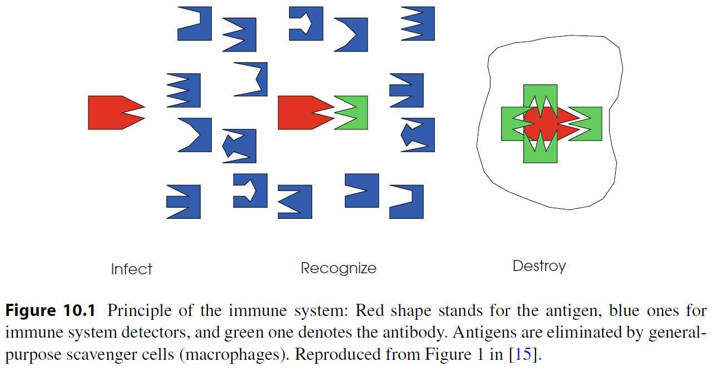

Slide 11
AIS has unique characteristics of pattern recognition, self-identity, optimization, and machine learning [6].
The adaptability of the immune system to diverse bacteria and viruses in the environment can conceptually be formulated as a multimodal function optimization problem, with the antibodies being points in the decision space and the antigens being the solutions.

Slide 12
10.2 Immunological Theories
The four main immunological theories are clonal selection, immune networks, negative selection, and danger theory.
Clonal selection and immune network theories form the basis for learning and memory mechanisms, while negative selection theory is used for detecting anomalous entities. The biological immune system exhibits immunological memory and tolerance.

Slide 13
Artificial immune networks operate through two types of dynamics:
  Short-term dynamics, which regulate the concentration of lymphocyte clones and immunoglobulins, functioning as cooperating or competing agents.
  Metadynamics, which recruit new lymphocyte species from the bone marrow, refining the results of short-term dynamics.
In this framework, short-term dynamics resemble evolution, while metadynamics resemble learning.

Slide 14
Clonal Selection Theory
Clonal selection theory explains how immune cells respond to antigens through clonal proliferation, generating effect cells and memory cells. Effect cells produce antibodies, which undergo duplication and mutation, gradually increasing their affinity until reaching affinity maturation.
This theory models the evolution of immune cells, enabling them to learn and memorize antigen patterns. High-affinity antibodies are selected as parents, proliferating asexually (mitosis) to produce offspring. These offspring undergo affinity maturation, replacing the parent only if their fitness value improves.
The clonal selection process consists of four steps: cloning, clonal crossover, clonal mutation, and clonal selection, forming a random antibody map based on affinity

Slide 15
Immune Networks
Immune network theory describes how B cells form an interconnected network, complementing clonal selection theory. When a B cell is stimulated by an antigen, it activates other B cells through its paratopes, while similar cells are suppressed, and new cells replace lost ones, maintaining population diversity and equilibrium.
B cells can edit their receptors by random genetic changes, potentially increasing affinity between antigen epitopes and antibodies. Upon activation, a B cell proliferates, stimulating neighboring cells to suppress the initial antibody response. Differential equations model idiotypic interactions, considering antigen recognition, cell death, and new cell influx.
Idiotypic network theory, derived from immune network theory, suggests that immune interactions occur not only between antigens and antibodies but also between antibodies themselves, leading to stimulatory or suppressive responses. These interactions contribute to immune tolerance and memory formation.

Slide 16
Negative Selection
Negative selection is a mechanism for distinguishing self from nonself to prevent self-destructive immune responses. The immune system eliminates antibodies that closely resemble self-cells, ensuring only nonself-reactive immune cells remain.
This process occurs in the thymus, where T cells recognizing self-cells are excluded, while those with low affinity for self-cells are tolerated and released into circulation. The negative selection algorithm models this biological process, enabling the immune system to generate mature T cells and identify previously unseen harmful cells.

Slide 17
Danger Theory
Danger theory, proposed by Matzinger in 1994, suggests that the immune system does not simply differentiate self from nonself, but instead responds to signs of damage. It explains immune reactions to self-antigens and nonself-antigens, highlighting how danger signals arise from abnormal biochemical reactions.
The immune system is triggered by danger signals, such as those produced by necrotic cells that die unexpectedly due to infection. Dendritic cells, a type of macrophage, act as intrusion detectors, monitoring tissues for pathogens. These cells interpret molecular signals and regulate T cell activation in lymph nodes.

Slide 18
Dendritic cells exist in three states:
  Immature state (initial detection phase).
  Semi-mature state (apoptotic death, normal cell function, no immune response).
  Mature state (necrotic death, danger detected, immune response activated).
Danger zones form around infected cells, activating immune responses. Pathogen-associated molecular patterns (PAMPs) signal the presence of microorganisms, while safe signals indicate healthy tissue function. Apoptosis leads to immune tolerance, whereas necrosis triggers immune activation.

Slide 19
10.3 Immune Algorithms
An Artificial Immune System (AIS) incorporates key properties of natural immune systems, including diversity, distributed computation, error tolerance, dynamic learning, adaptation, and self-monitoring. The immune system learns to distinguish between dangerous and nondangerous pathogens, and clonal selection is commonly used in immune algorithms due to its self-organizing and learning capabilities.

Slide 20
AIS is similar to Genetic Algorithms (GA):
  Antigens/pathogens represent the problem to optimize.
  Antibodies serve as candidate solutions.
  Affinity between antibodies and antigens corresponds to solution quality.
  Nonself-antigens act as constraints.
Like Evolutionary Algorithms (EAs), immune algorithms evolve solutions through cloning, mutation, and selection cycles, refining the population of candidate solutions. Additionally, antigens can be defined as patterns to recognize or training data in learning-based applications.

Slide 21
10.3.1 Clonal Selection Algorithm
The Clonal Selection Algorithm (CLONALG) simulates the activation process of immune cells, searching for global optimal solutions through cloning and high-frequency variation of immune cells that recognize antigens. It mimics learning and affinity maturation in B cells, using antibodies to represent immune cells.
CLONALG is based on clonal selection and affinity maturation, leveraging proliferation and differentiation to reproduce strong solutions while eliminating weak ones. Affinity maturation corresponds to learning from new patterns, with solution quality measured by affinity toward antigens (fitness).

Slide 22
Key processes include:
  Selection: Only lymphocytes recognizing antigens proliferate.
  Affinity maturation: Selected lymphocytes improve their affinity through hypermutation, refining local solutions.
  Elimination and replacement: Low-affinity antibodies are removed or undergo receptor editing to enhance affinity.
  Memory cells: Store candidate solutions and regulate antibody concentration through stimulation or suppression.
  Genetic operators: Introduce antibody diversity to capture unknown antigens.
CLONALG ensures adaptive learning, refining solutions through recognition, affinity calculation, and controlled antibody dispersion

Slide 23
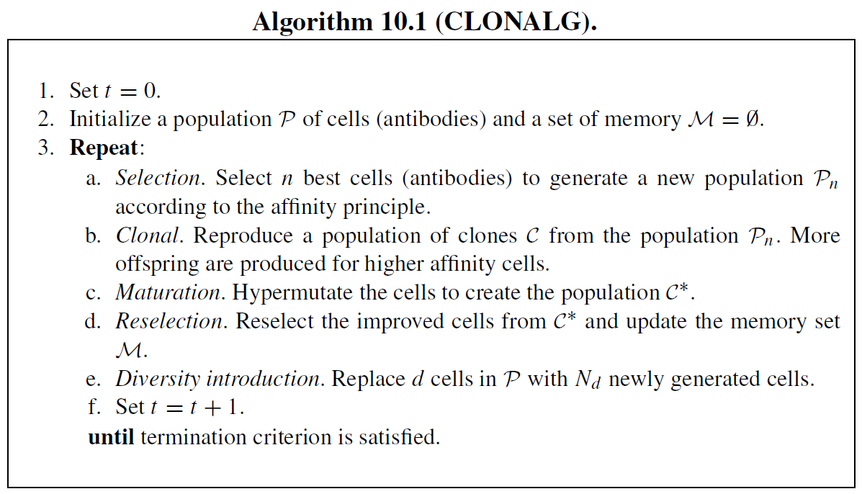

Slide 24
CLONALG, described in Algorithm 10.1, assigns lower mutation rates to higher-affinity cells to keep them near local optima, while lower-affinity cells undergo higher mutation rates to explore other regions. Lower-affinity cells also have a higher probability of being replaced.
For multimodal problems, multiple optima must be located within a single antibody population. In this case, all antibodies are cloned equally, rather than using affinity-proportionate cloning. Hypermutation rates remain proportional to affinity, ensuring adaptive search.

Slide 25
CLONALG vs. Genetic Algorithms (GA):
  Mutation-based, but no crossover operation.
  Proportionate selection and inverse-affinity hypermutation.
  Unique cloning step and elitism mechanism.
  Binary representation in antibodies.
  Maintains multiple optima, unlike GA, which converges toward a single best solution.
  Parallel optimization, similar to (1 + round(βNP)-ES) with adaptive mutation control, where β is the clone factor and NP is the population size.

Slide 26
CLONALG favors high-affinity antibodies, making it well-suited for high-peak problems. Algorithmic parameters must be user-defined, though they have been evolved in later studies.
Several enhancements have been introduced:
  Antibody clustering expands a single population into multiple subpopulations, with competition selection ensuring the best antibody represents each cluster. Gaussian mutation aids local search, while Cauchy mutation explores new areas
  Aging mechanisms assign age values to search points, allowing equal opportunity for exploration. Aging can be replaced by restart strategies for improved performance.

Slide 27
The immune system helps maintain diversity in Genetic Algorithms (GA) for multimodal optimization problems by constructing populations of antigens and antibodies. Matching occurs when an antibody’s bit string is complementary to an antigen’s bit string, and fitness values are assigned based on this matching.
A simple GA then replicates antibodies that best match the antigens, allowing GA to evolve and sustain a diverse, cooperative population. This process is similar to fitness sharing in GA, ensuring pattern-matching antibodies effectively recognize antigen patterns while maintaining population diversity.

Slide 28
10.3.2 Artificial Immune Network
aiNet (Artificial Immune Network) combines CLONALG with immune network theory for optimization problems. It is a competitive, constructive network, where antibodies act as network nodes, with concentration and affinity as their states. Learning adjusts antibody concentration and affinity, determining which nodes are cloned, suppressed, or maintained based on affinity interactions. The goal is to build a memory set that represents antigenic spatial distribution.

Slide 29
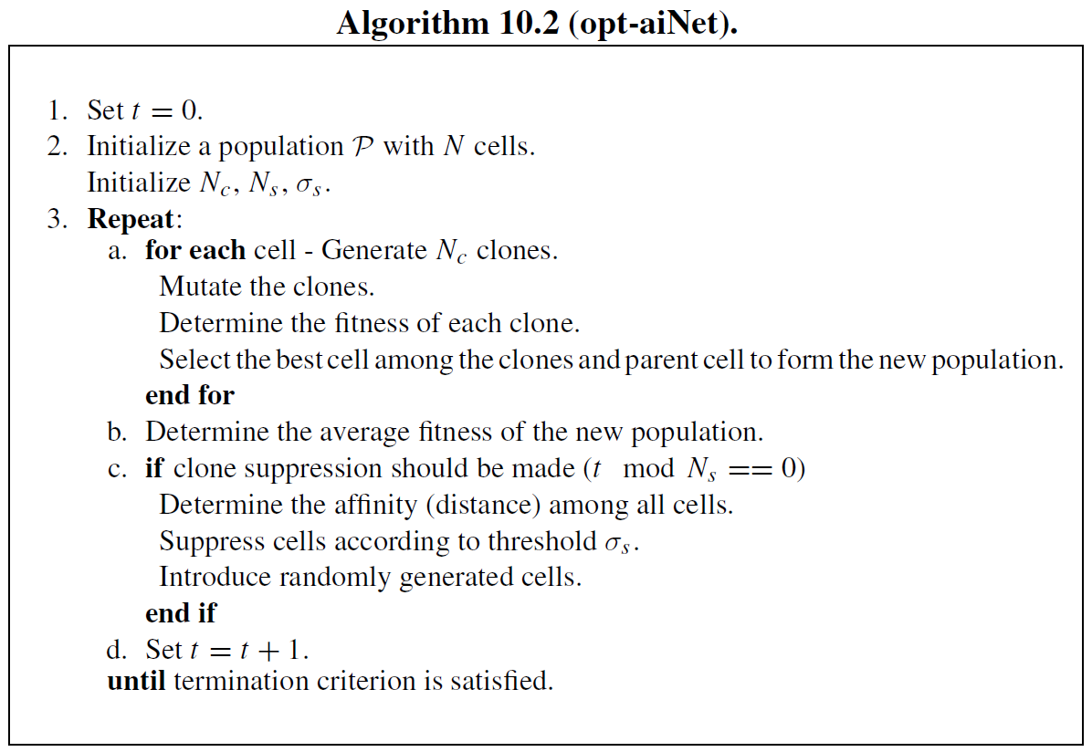

Slide 30
Variants of aiNet:
  Optimized aiNet (opt-aiNet): Designed for multimodal optimization, maintaining multiple optimal solutions and dynamically adjusting population size. It selects elitist antibodies from clones, eliminates redundant cells, and introduces new antibodies for exploration. Affinity is measured by Euclidean distance, and the algorithm has quadratic complexity.
  Omni-aiNet: Ensures self-maintenance of diversity, simultaneous search for multiple high-quality solutions, and adaptive population adjustment.
  dopt-aiNet: Enhances population diversity and solution refinement for dynamic optimization, using golden section line search and two mutation operators (one-dimensional mutation and gene duplication).
  dt-aiNet: Integrates danger theory into aiNet, improving solution quality and population diversity.

Slide 31
  Bayesian AIS, inspired by Estimation of Distribution Algorithms (EDAs), replaces mutation and cloning with a Bayesian network, dynamically adjusting population size for multimodal optimization.
  Vaccine-enhanced AIS promotes exploration by introducing weak antigens as vaccines, enabling parallel searches across subpopulations.
  Immune mechanisms can be integrated into Genetic Algorithms (GA) as genetic operators, improving crossover and mutation by vaccination and immune selection, ensuring steady fitness improvement

Slide 32
10.3.3 Negative Selection Algorithm
The Negative Selection Algorithm (NSA) is inspired by the negative selection mechanism in the immune system, enabling the detection of unknown antigens. It efficiently operates in linear time for binary strings.

Slide 33
NSA Process:
  Self-pattern profiling: Normal patterns are treated as self-patterns, representing typical data properties.
  Detector generation: Random detector patterns are created and compared against self-patterns. If a detector matches a self-pattern, it is discarded; otherwise, it is retained.
  Anomaly detection: During monitoring, if a detector matches a new pattern, an anomaly is detected, indicating data corruption or alteration.

Slide 34
Applications:
  Anomaly detection, including computer security and network intrusion detection systems.
  Receptor Density Algorithm, inspired by T-cell receptor mechanisms, detects anomalies by placing receptors at discretized locations and classifying inputs as normal or anomalous using stochastic analysis.

Slide 35
10.3.4 Dendritic Cell Algorithm
Danger theory inspires a robust, distributed, adaptive, and autonomous detection mechanism for early outbreak notification with high detection accuracy.
Dendritic Cell Algorithm (DCA):
  Population-based algorithm inspired by dendritic cells in the human immune system.
  Applies danger theory for anomaly detection in time-series datasets.
  No training phase required; normality and anomaly are determined through statistical analysis.
  Linear computational complexity, making it fast and efficient for anomaly detection.
  High detection rate with low false alarm rate.

Slide 36
Mechanism:
  Each dendritic cell follows specific instructions, performing antigen sampling and signal collection.
  Fusion of multiple data streams allows contextual anomaly detection.
  Diversity is introduced through cell migration.
  Three signal types:
    PAMP signal → Strong indicator of anomaly.
    Danger signal → Potential abnormality.
    Safe signal → Normal, steady-state behavior.
  Predefined signal weights help evaluate system status.
  Danger zones adjust antibody concentrations, triggering immune responses.

Slide 37
Process:
  Input data mapped to the problem domain.
  Signals represented as real-valued vectors.
  Antigens classified as categorical values.
  Algorithm identifies past anomalies based on input data.
  Correlates anomalies with potential causes, generating an anomaly scene per suspect.

Slide 38
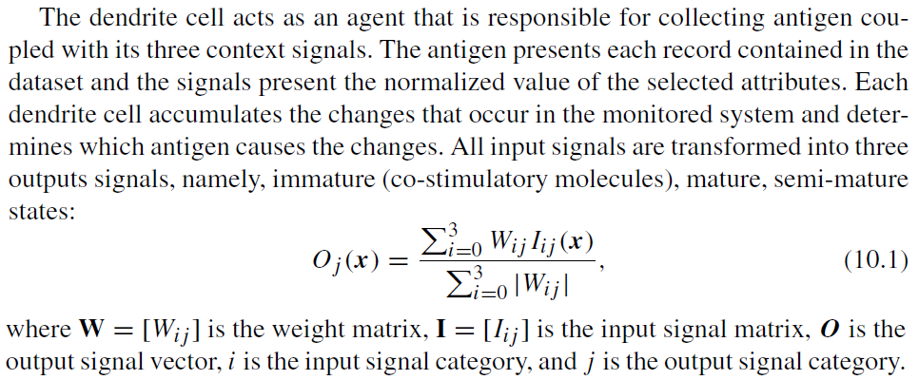

Slide 39
The dendritic cell samples input signals and antigens multiple times, similar to how dendritic cells in the human body hold suspected antigens until maturation. The sampling process increases the cell’s experience, documented in three output signals:
  Immature (O1)
  Mature (O2)
  Semi-mature (O3)

Slide 40
Process:
Sampling continues until O1 reaches the migration threshold, triggering cell migration for antigen presentation.
After migration, O2 and O3 are compared to determine the antigen’s context:
  Mature antigen → If O2 > O3.
  Semi-mature antigen → If O2 < O3.
The migrated dendritic cell is replaced with a new cell, restarting sampling.
This iterative process ensures continuous antigen detection and classification.

Slide 41
Applications:
  Prototype dendritic cell algorithm applied to binary classification, using time stamps as antigens and features forming signal categories.
  Deterministic dendritic cell algorithm removes randomness, providing a more controllable system.

