Slide 1
10 Artificial Immune Systems
Ke-Lin Du and M.N.S. Swamy, Search and Optimization by Metaheuristics - Techniques and Algorithms Inspired by Nature, Springer, 2016

Slide 2
AISs are based on four main immunological theories
  clonal selection
  immune networks
  Negative selection
  danger theory
This chapter introduces four immune algorithms inspired by the four immunological theories.

Slide 3
10.1 Introduction
An Artificial Immune System (AIS) is inspired by the biological immune system, which protects the body by detecting and eliminating pathogens, tumor cells, and malfunctioning cells. The immune system distinguishes between self and nonself molecules and maintains diversity in its immune repertoire.

Slide 4
Vertebrate immune systems defend against viruses, bacteria, parasites, and fungi without prior knowledge of specific pathogens. Memory cells store information about previously encountered threats, enabling rapid responses to future infections. This adaptive, distributed, and self-organized nature makes the immune system a valuable model for computer science applications, such as intrusion detection systems.

Slide 5
The immune system consists of organs like the thymus, spleen, and lymph nodes, along with a vast number of immune cells. Like the neural system, it exhibits high robustness. Its two fundamental components are B lymphocytes (B cells) and T lymphocytes (T cells), which play crucial roles in immune defense.

Slide 6
B lymphocytes and T lymphocytes originate in the bone marrow, but B cells mature in the spleen, while T cells mature in the thymus. Both encounter antigens, proliferate, and evolve into fully functional immune cells. Cell-mediated immunity is driven by T lymphocytes, while humoral immunity is mediated by antibodies secreted by B lymphocytes.

Slide 7
B cells recognize antigens using immunoglobulin (Ig) receptors and, upon activation, differentiate into plasma cells, which produce antibodies that bind to antigens and trigger their destruction by phagocytes. T lymphocytes regulate B cell antibody production and proliferate upon encountering antigens with major histocompatibility complex (MHC) molecules, forming memory cells.

Slide 8
Lymphocytes remain passive until encountering antigens, after which they develop immunological memory, allowing rapid response to future infections. Some B cells differentiate into memory cells, which persist in circulation. Upon antigen exposure, B cells undergo somatic hypermutation, enhancing antibody affinity. Macrophages eliminate damaged antigens.

Slide 9
The immune system distinguishes self from nonself. Vaccination artificially induces immune memory by exposing the body to attenuated or dead pathogens, enabling rapid defense against real infections.

Slide 10
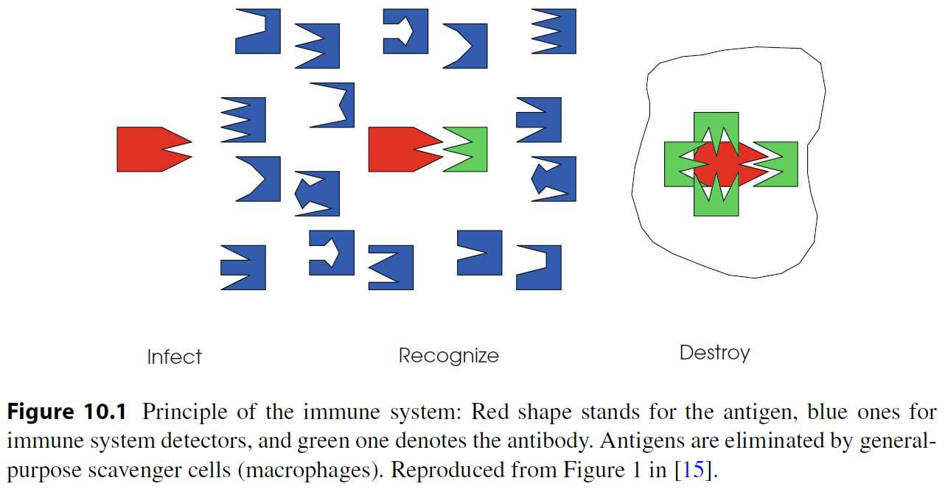

Slide 11
AIS has unique characteristics of pattern recognition, self-identity, optimization, and machine learning [6].
The adaptability of the immune system to diverse bacteria and viruses in the environment can conceptually be formulated as a multimodal function optimization problem, with the antibodies being points in the decision space and the antigens being the solutions.

Slide 12
10.2 Immunological Theories
The four main immunological theories are clonal selection, immune networks, negative selection, and danger theory.
Clonal selection and immune network theories form the basis for learning and memory mechanisms, while negative selection theory is used for detecting anomalous entities. The biological immune system exhibits immunological memory and tolerance.

Slide 13
Artificial immune networks operate through two types of dynamics:
  Short-term dynamics, which regulate the concentration of lymphocyte clones and immunoglobulins, functioning as cooperating or competing agents.
  Metadynamics, which recruit new lymphocyte species from the bone marrow, refining the results of short-term dynamics.
In this framework, short-term dynamics resemble evolution, while metadynamics resemble learning.

Slide 14
Clonal Selection Theory
Clonal selection theory explains how immune cells respond to antigens through clonal proliferation, generating effect cells and memory cells. Effect cells produce antibodies, which undergo duplication and mutation, gradually increasing their affinity until reaching affinity maturation.
This theory models the evolution of immune cells, enabling them to learn and memorize antigen patterns. High-affinity antibodies are selected as parents, proliferating asexually (mitosis) to produce offspring. These offspring undergo affinity maturation, replacing the parent only if their fitness value improves.
The clonal selection process consists of four steps: cloning, clonal crossover, clonal mutation, and clonal selection, forming a random antibody map based on affinity

Slide 15
Immune Networks
Immune network theory describes how B cells form an interconnected network, complementing clonal selection theory. When a B cell is stimulated by an antigen, it activates other B cells through its paratopes, while similar cells are suppressed, and new cells replace lost ones, maintaining population diversity and equilibrium.
B cells can edit their receptors by random genetic changes, potentially increasing affinity between antigen epitopes and antibodies. Upon activation, a B cell proliferates, stimulating neighboring cells to suppress the initial antibody response. Differential equations model idiotypic interactions, considering antigen recognition, cell death, and new cell influx.
Idiotypic network theory, derived from immune network theory, suggests that immune interactions occur not only between antigens and antibodies but also between antibodies themselves, leading to stimulatory or suppressive responses. These interactions contribute to immune tolerance and memory formation.

Slide 16
Negative Selection
Negative selection is a mechanism for distinguishing self from nonself to prevent self-destructive immune responses. The immune system eliminates antibodies that closely resemble self-cells, ensuring only nonself-reactive immune cells remain.
This process occurs in the thymus, where T cells recognizing self-cells are excluded, while those with low affinity for self-cells are tolerated and released into circulation. The negative selection algorithm models this biological process, enabling the immune system to generate mature T cells and identify previously unseen harmful cells.

Slide 17
Danger Theory
Danger theory, proposed by Matzinger in 1994, suggests that the immune system does not simply differentiate self from nonself, but instead responds to signs of damage. It explains immune reactions to self-antigens and nonself-antigens, highlighting how danger signals arise from abnormal biochemical reactions.
The immune system is triggered by danger signals, such as those produced by necrotic cells that die unexpectedly due to infection. Dendritic cells, a type of macrophage, act as intrusion detectors, monitoring tissues for pathogens. These cells interpret molecular signals and regulate T cell activation in lymph nodes.

Slide 18
Dendritic cells exist in three states:
  Immature state (initial detection phase).
  Semi-mature state (apoptotic death, normal cell function, no immune response).
  Mature state (necrotic death, danger detected, immune response activated).
Danger zones form around infected cells, activating immune responses. Pathogen-associated molecular patterns (PAMPs) signal the presence of microorganisms, while safe signals indicate healthy tissue function. Apoptosis leads to immune tolerance, whereas necrosis triggers immune activation.

Slide 19
10.3 Immune Algorithms
An Artificial Immune System (AIS) incorporates key properties of natural immune systems, including diversity, distributed computation, error tolerance, dynamic learning, adaptation, and self-monitoring. The immune system learns to distinguish between dangerous and nondangerous pathogens, and clonal selection is commonly used in immune algorithms due to its self-organizing and learning capabilities.

Slide 20
AIS is similar to Genetic Algorithms (GA):
  Antigens/pathogens represent the problem to optimize.
  Antibodies serve as candidate solutions.
  Affinity between antibodies and antigens corresponds to solution quality.
  Nonself-antigens act as constraints.
Like Evolutionary Algorithms (EAs), immune algorithms evolve solutions through cloning, mutation, and selection cycles, refining the population of candidate solutions. Additionally, antigens can be defined as patterns to recognize or training data in learning-based applications.

Slide 21
10.3.1 Clonal Selection Algorithm
The Clonal Selection Algorithm (CLONALG) simulates the activation process of immune cells, searching for global optimal solutions through cloning and high-frequency variation of immune cells that recognize antigens. It mimics learning and affinity maturation in B cells, using antibodies to represent immune cells.
CLONALG is based on clonal selection and affinity maturation, leveraging proliferation and differentiation to reproduce strong solutions while eliminating weak ones. Affinity maturation corresponds to learning from new patterns, with solution quality measured by affinity toward antigens (fitness).

Slide 22
Key processes include:
  Selection: Only lymphocytes recognizing antigens proliferate.
  Affinity maturation: Selected lymphocytes improve their affinity through hypermutation, refining local solutions.
  Elimination and replacement: Low-affinity antibodies are removed or undergo receptor editing to enhance affinity.
  Memory cells: Store candidate solutions and regulate antibody concentration through stimulation or suppression.
  Genetic operators: Introduce antibody diversity to capture unknown antigens.
CLONALG ensures adaptive learning, refining solutions through recognition, affinity calculation, and controlled antibody dispersion

Slide 23
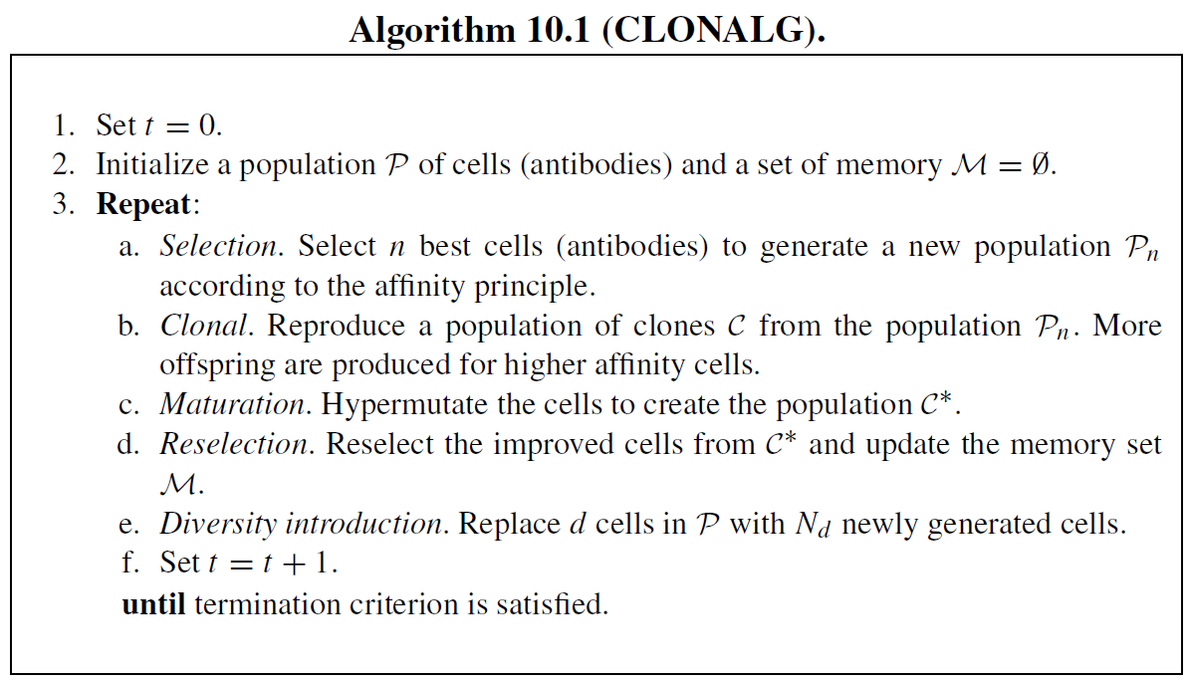

Slide 24
CLONALG, described in Algorithm 10.1, assigns lower mutation rates to higher-affinity cells to keep them near local optima, while lower-affinity cells undergo higher mutation rates to explore other regions. Lower-affinity cells also have a higher probability of being replaced.
For multimodal problems, multiple optima must be located within a single antibody population. In this case, all antibodies are cloned equally, rather than using affinity-proportionate cloning. Hypermutation rates remain proportional to affinity, ensuring adaptive search.

Slide 25
CLONALG vs. Genetic Algorithms (GA):
  Mutation-based, but no crossover operation.
  Proportionate selection and inverse-affinity hypermutation.
  Unique cloning step and elitism mechanism.
  Binary representation in antibodies.
  Maintains multiple optima, unlike GA, which converges toward a single best solution.
  Parallel optimization, similar to (1 + round(βNP)-ES) with adaptive mutation control, where β is the clone factor and NP is the population size.

Slide 26
CLONALG favors high-affinity antibodies, making it well-suited for high-peak problems. Algorithmic parameters must be user-defined, though they have been evolved in later studies.
Several enhancements have been introduced:
  Antibody clustering expands a single population into multiple subpopulations, with competition selection ensuring the best antibody represents each cluster. Gaussian mutation aids local search, while Cauchy mutation explores new areas
  Aging mechanisms assign age values to search points, allowing equal opportunity for exploration. Aging can be replaced by restart strategies for improved performance.

Slide 27
The immune system helps maintain diversity in Genetic Algorithms (GA) for multimodal optimization problems by constructing populations of antigens and antibodies. Matching occurs when an antibody’s bit string is complementary to an antigen’s bit string, and fitness values are assigned based on this matching.
A simple GA then replicates antibodies that best match the antigens, allowing GA to evolve and sustain a diverse, cooperative population. This process is similar to fitness sharing in GA, ensuring pattern-matching antibodies effectively recognize antigen patterns while maintaining population diversity.

Slide 28
Clonal Selection Algorithm (CSA) Tutorial
In artificial intelligence, the Clonal Selection Algorithm (CSA) is a metaheuristic optimization algorithm inspired by the clonal selection principle of the acquired immune system. It's particularly useful for problems involving pattern recognition, optimization, and machine learning.

Slide 29
1. Introduction to Artificial Immune Systems (AIS)
Before diving into CSA, it's helpful to understand the basic premise of Artificial Immune Systems (AIS). AIS are a class of computational intelligence systems inspired by the principles and processes of the vertebrate immune system. They leverage concepts like:
  Diversity: The immune system maintains a diverse population of cells to recognize a wide range of pathogens.
  Adaptation/Learning: It learns to recognize new threats and strengthens its response over time.
  Memory: It remembers past encounters to provide faster and stronger responses to recurring threats.
  Self-organization: It operates in a decentralized and self-organizing manner.

Slide 30
2. The Biological Inspiration: Clonal Selection Principle
The Clonal Selection Algorithm specifically draws inspiration from the clonal selection principle in immunology. This principle describes how B cells (a type of white blood cell) in the immune system respond to antigens (foreign substances):
  Antigen Recognition: When a B cell encounters an antigen that it can bind to, it becomes activated.
  Clonal Proliferation: The activated B cell rapidly proliferates (clones itself), creating a large number of identical copies.
  Somatic Hypermutation: During this proliferation, a high rate of mutation occurs in the antibody-encoding genes of the B cells. This introduces variation in the affinity (binding strength) of the antibodies produced by the cloned cells.

Slide 31
  Affinity Maturation & Selection: B cells with higher affinity for the antigen are preferentially selected to continue proliferating and differentiating. This process is known as "affinity maturation."
  Differentiation: Selected B cells differentiate into either:
  Plasma Cells: Short-lived cells that produce large quantities of antibodies.
  Memory Cells: Long-lived cells that provide immunological memory for future encounters with the same antigen.
The key takeaway is that the immune system refines its response by selecting and amplifying cells that are most effective against a particular threat.

Slide 32
3. Core Concepts in CSA
Translating the biological principles into an algorithm, we define the following analogous concepts:
  Antibodies (Solutions/Candidate Solutions): In CSA, an "antibody" represents a candidate solution to the optimization problem. Each antibody has a specific structure (e.g., a vector of real numbers, a bit string) that encodes a potential solution.
  Antigens (Problem/Objective Function): The "antigen" represents the problem to be solved or the objective function to be optimized. The goal is to find antibodies that "match" or "bind" well to the antigen (i.e., provide good solutions to the problem).
  Affinity (Fitness/Quality): "Affinity" measures how well an antibody matches an antigen. In an optimization context, it's equivalent to the fitness or quality of a candidate solution, typically evaluated by the objective function. Higher affinity means a better solution.
  Cloning (Replication/Duplication): Good solutions (antibodies with high affinity) are "cloned" or replicated, generating multiple copies. The number of clones is usually proportional to their affinity.

Slide 33
  Somatic Hypermutation (Mutation): Cloned antibodies undergo "somatic hypermutation," which is a process of introducing random changes to their structure. The mutation rate is often inversely proportional to affinity (i.e., less mutation for high-affinity clones, more for low-affinity clones). This helps in local search around good solutions and exploring new regions.
  Selection (Environmental Selection): After mutation, the mutated clones are evaluated, and only the "best" (highest affinity) ones are selected to survive and potentially contribute to the next generation.
  Memory Cells (Elite Solutions/Best Solutions): A set of "memory cells" can be maintained to store the best solutions found so far, preventing their loss and aiding in convergence.
  Diversity (Receptor editing/Population Replacement): Mechanisms to maintain diversity in the population are crucial to avoid premature convergence to local optima. This can involve replacing low-affinity antibodies with newly generated random ones.

Slide 34
4. The Clonal Selection Algorithm Steps
The general steps of a basic Clonal Selection Algorithm are as follows:
Initialization:
  Generate an initial population of random antibodies (candidate solutions). This population should be diverse.
  Initialize a set of memory cells (optional, but recommended for storing best solutions).
Evaluation:
  Evaluate the affinity (fitness) of each antibody in the current population against the antigen (objective function).
Selection for Cloning:
  Select a subset of the best antibodies (highest affinity) from the current population for cloning. The number of selected antibodies can be a fixed percentage or based on a threshold.
Cloning:
  Generate a number of clones for each selected antibody. The number of clones for an antibody is typically proportional to its affinity (better antibodies get more clones).
Somatic Hypermutation:
  Mutate each of the cloned antibodies. The mutation rate is often inversely proportional to the antibody's affinity. This means that highly fit antibodies undergo smaller mutations (local search), while less fit antibodies undergo larger mutations (exploration).

Slide 35
Re-evaluation of Clones:
  Evaluate the affinity of all the mutated clones.
Clonal Selection (Environmental Selection):
  From the original selected antibodies and their mutated clones, select the best (highest affinity) ones to form a new temporary population. This ensures that only improved or equally good solutions are retained.
Memory Cell Update (Optional but Recommended):
  Update the memory cell set with the best antibody found in the current generation. If the new best antibody is better than any in the memory, it replaces the worst one or is added if there's space.
Diversity Introduction (Replacement/Immigration):
  To maintain diversity and prevent premature convergence, replace a certain percentage of the lowest-affinity antibodies in the current population with newly generated random antibodies. This simulates the continuous generation of new B cells in the immune system.
Termination Criteria:
  Repeat steps 2-9 until a termination criterion is met (e.g., maximum number of generations, satisfactory solution found, no significant improvement for a certain number of generations).

Slide 36
5. Pseudocode Example
Algorithm ClonalSelectionAlgorithm:
Input: Objective Function F, Population Size N, Number of Clones Nc, Mutation Rate M, Replacement Rate R, Max Generations G
Output: Best Solution found
1. Initialize Population P with N random antibodies (solutions).
2. Initialize Memory_Cells (empty or with initial best solutions).
3. For generation = 1 to G:
a. Evaluate affinity of each antibody in P using F.
b. Sort P by affinity (descending).
c. Select top 'k' antibodies (e.g., a percentage of N) for cloning, let this set be P_selected.

Slide 37
d. For each antibody A in P_selected:
i. Calculate number of clones for A (proportional to its affinity).
ii. Generate clones_A by replicating A.
iii. Mutate each clone in clones_A: apply mutation operator with rate inversely proportional to A's affinity.
e. Combine all mutated clones into a temporary population P_clones.
f. Evaluate affinity of each antibody in P_clones.
g. Select the best 'N' antibodies from (P_selected U P_clones) to form the new population P. (This ensures that if mutated clones are better, they replace their parents; otherwise, parents are retained).
h. Update Memory_Cells: Add the best antibody from P to Memory_Cells (e.g., replace the worst if it's better).
i. Introduce Diversity: Replace the lowest 'R' percentage of antibodies in P with newly generated random antibodies.
4. Return the best solution from Memory_Cells.

Slide 38
6. Parameters and Considerations
Population Size (N): Affects exploration and exploitation. Larger populations can explore more, but at a higher computational cost.
Number of Clones (Nc): Controls the intensity of local search around good solutions.
Mutation Rate (M): Crucial for balancing exploration and exploitation. A common strategy is to make it inversely proportional to affinity.
Replacement Rate (R): Controls the amount of diversity introduced. Too high, and the algorithm becomes too random; too low, and it might get stuck in local optima.
Selection Strategy: How the "best" antibodies are selected for cloning.
Mutation Operator: Depends on the problem representation (e.g., Gaussian mutation for real-valued, bit-flip for binary).
Affinity Function: Directly related to the objective function of the problem.

Slide 39
7. Advantages of CSA
Good for multimodal problems: The diversity introduction and mutation strategies help escape local optima.
Robustness: Can handle noisy environments due to its inherent selection mechanisms.
Implicit parallelism: Explores multiple regions of the search space simultaneously.
Inspired by a natural process: Offers an intuitive understanding.

Slide 40
8. Limitations of CSA
Parameter tuning: Like many metaheuristics, CSA can be sensitive to parameter settings.
Computational cost: Cloning and mutation can be computationally intensive, especially for large populations and many clones.
Convergence speed: May be slower than some other algorithms for certain problem types.

Slide 41
9. Applications
CSA has been successfully applied to a wide range of problems, including:
  Function optimization: Finding the global optimum of complex mathematical functions.
  Pattern recognition: Image classification, data clustering.
  Machine learning: Training neural networks, feature selection.
  Robotics: Path planning.
  Scheduling and resource allocation.

Slide 42
Clonal_Selection_Algorithm.ipynb
clonal_selection_algorithm.py

Slide 43
10.3.2 Artificial Immune Network
aiNet (Artificial Immune Network) combines CLONALG with immune network theory for optimization problems. It is a competitive, constructive network, where antibodies act as network nodes, with concentration and affinity as their states. Learning adjusts antibody concentration and affinity, determining which nodes are cloned, suppressed, or maintained based on affinity interactions. The goal is to build a memory set that represents antigenic spatial distribution.

Slide 44
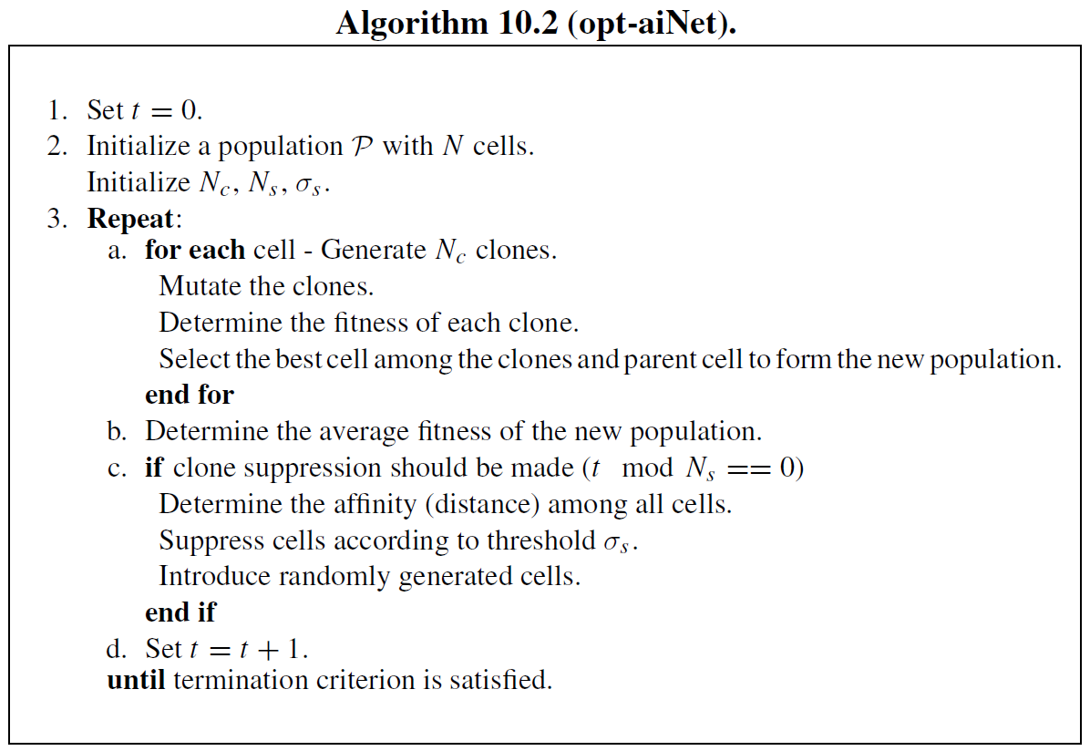

Slide 45
Variants of aiNet:
  Optimized aiNet (opt-aiNet): Designed for multimodal optimization, maintaining multiple optimal solutions and dynamically adjusting population size. It selects elitist antibodies from clones, eliminates redundant cells, and introduces new antibodies for exploration. Affinity is measured by Euclidean distance, and the algorithm has quadratic complexity.
  Omni-aiNet: Ensures self-maintenance of diversity, simultaneous search for multiple high-quality solutions, and adaptive population adjustment.
  dopt-aiNet: Enhances population diversity and solution refinement for dynamic optimization, using golden section line search and two mutation operators (one-dimensional mutation and gene duplication).
  dt-aiNet: Integrates danger theory into aiNet, improving solution quality and population diversity.

Slide 46
  Bayesian AIS, inspired by Estimation of Distribution Algorithms (EDAs), replaces mutation and cloning with a Bayesian network, dynamically adjusting population size for multimodal optimization.
  Vaccine-enhanced AIS promotes exploration by introducing weak antigens as vaccines, enabling parallel searches across subpopulations.
  Immune mechanisms can be integrated into Genetic Algorithms (GA) as genetic operators, improving crossover and mutation by vaccination and immune selection, ensuring steady fitness improvement

Slide 47
Artificial Immune Network Tutorial
Artificial Immune Networks (AINs) are a fascinating branch of Artificial Immune Systems (AIS), which are computational intelligence techniques inspired by the remarkable defense mechanisms of the biological immune system.
AINs, in particular, draw their inspiration from the idiotypic network theory proposed by Niels Jerne, suggesting that antibodies in the immune system don't just react to foreign invaders (antigens) but also interact with each other, forming a complex regulatory network of stimulation and suppression.

Slide 48
1. The Biological Inspiration: Jerne's Idiotypic Network Theory
To understand AINs, it's essential to grasp the underlying biological concept:
  Antigens: These are foreign substances (like viruses, bacteria, or toxins) that trigger an immune response. In computational terms, antigens often represent the problems to be solved or patterns to be recognized.
  Antibodies: These are proteins produced by B cells in the immune system that specifically recognize and bind to antigens, neutralizing them. In AINs, antibodies are typically candidate solutions to a problem or data representations.

Slide 49
  Affinity: This refers to the strength of the binding between an antigen and an antibody, or between two antibodies. Higher affinity means a better "match" or stronger interaction.
  Idiotypic Network: Jerne's theory posits that antibodies don't just interact with antigens but also with other antibodies. An antibody's "idiotype" is its unique binding site. Anti-idiotypic antibodies are antibodies that recognize the idiotype of other antibodies. This forms a complex network where antibodies can stimulate or suppress the production of other antibodies, leading to a dynamic and self-regulating system. This network helps maintain diversity, memory, and prevents overreaction to specific threats.

Slide 50
2. Core Concepts of Artificial Immune Networks
AINs abstract these biological principles into computational models:
  Antibody Population: An AIN typically starts with a population of "artificial antibodies," each representing a potential solution or data point in the problem space.
  Antigen (Problem): The problem to be solved or the data to be processed is represented as an "antigen."
  Affinity Measure: A metric is defined to quantify the "affinity" or similarity between antibodies and antigens, or between different antibodies. Common measures include Euclidean distance, Hamming distance, or other problem-specific similarity functions.
  Network Structure: Antibodies are connected to each other based on their affinity. High-affinity connections imply strong interaction (stimulation or suppression), while low-affinity connections are weak or non-existent.

Slide 51
  Stimulation and Suppression:
    Stimulation: Antibodies with high affinity to antigens (good solutions) are stimulated to proliferate (clone) and diversify (mutate), exploring the solution space around good candidates.
    Suppression: Antibodies that are too similar to each other or to existing "memory" antibodies might be suppressed to maintain diversity and prevent redundancy. This helps avoid local optima and encourages exploration of different regions of the solution space.
  Memory: AINs often incorporate a memory mechanism, where highly effective antibodies (solutions) are stored for future use, similar to how the immune system remembers past infections.
  Diversity: Maintaining diversity within the antibody population is crucial to explore the problem space effectively and prevent premature convergence.

Slide 52
3. How Artificial Immune Networks Work (General Framework)
While specific algorithms vary, the general workflow of an AIN often follows these steps:
  Initialization: Create an initial population of random or quasi-random antibodies (candidate solutions).
  Antigen Presentation/Problem Evaluation: Present the "antigen" (the problem data or objective function) to the antibody population.
  Affinity Calculation: For each antibody, calculate its affinity to the antigen. This measures how well the antibody "solves" the problem.
  Clonal Selection/Proliferation: Antibodies with higher affinity to the antigen are selected and cloned (copied). The number of clones is usually proportional to their affinity.

Slide 53
  Somatic Hypermutation: The cloned antibodies undergo mutation, introducing small variations. This explores the local neighborhood of promising solutions. The mutation rate can sometimes be inversely proportional to affinity (higher affinity, lower mutation, for fine-tuning; lower affinity, higher mutation, for broader exploration).
  Network Interaction (Stimulation and Suppression):
    Calculate the affinity between all pairs of antibodies in the current population (including mutated clones and existing antibodies).
    Stimulation: Antibodies are stimulated by others with high affinity, leading to further proliferation or strengthening of connections.
    Suppression: Antibodies that are too similar to others, or that are redundant, are suppressed or eliminated. This mechanism helps prune the network, reduce redundancy, and maintain diversity. A "suppression threshold" is often used.

Slide 54
  Memory Cell Update: Identify the best-performing antibodies (e.g., those with the highest affinity or representing distinct optima) and add them to a "memory set" or update existing memory cells.
  Replacement/Diversity Maintenance: Replace suppressed or low-performing antibodies with new, randomly generated ones to introduce fresh diversity into the population.
  Iteration: Repeat steps 2-8 for a defined number of iterations or until a convergence criterion is met.
  Result: The best antibody(ies) from the memory set or the current population are considered the solution(s) to the problem.

Slide 55
4. Popular Artificial Immune Network Algorithms
Several specific AIN algorithms have been developed, each with its own nuances:
  aiNet (Artificial Immune Network): One of the most well-known AIN algorithms, often used for clustering and optimization. It focuses on building a network of "memory cells" that represent the structure of the input data. It uses concepts like clonal selection, somatic hypermutation, and a network suppression mechanism to refine and compress the data.
  CLONALG (Clonal Selection Algorithm): While not strictly an AIN in the "network" sense, CLONALG is a foundational AIS algorithm that often forms a component of AINs. It emphasizes the clonal selection principle, where B cells (antibodies) are selected, cloned, and mutated in proportion to their affinity to antigens.
  AINE (Artificial Immune Network for Data Clustering): Another algorithm specifically designed for data clustering, which also uses network interactions to identify natural groupings in data.

Slide 56
5. Applications of Artificial Immune Networks
The properties of the immune system – robustness, adaptability, learning, memory, and distributed processing – make AINs suitable for a variety of complex computational problems:
  Clustering: AINs excel at grouping similar data points into clusters, often without requiring prior knowledge of the number of clusters. This is a common application of algorithms like aiNet.
  Optimization: AINs can be used to find optimal or near-optimal solutions to complex optimization problems, including continuous function optimization.
  Pattern Recognition: Their ability to recognize and classify patterns makes them useful in areas like image recognition and anomaly detection.

Slide 57
  Anomaly/Intrusion Detection: By learning "normal" patterns, AINs can identify deviations or "anomalies," which is valuable for detecting network intrusions, fraudulent activities, or system malfunctions.
  Data Mining: AINs can help extract meaningful information and relationships from large datasets.
  Robotics: For tasks requiring autonomous decision-making and adaptation in dynamic environments.
  Control Systems: Their adaptive nature makes them suitable for designing robust control systems.

Slide 58
6. Advantages and Disadvantages of Artificial Immune Networks
Advantages:
  Robustness: Inspired by the immune system's resilience to diverse and unknown threats.
  Adaptability: Can adapt to changing environments and learn new patterns.
  Distributed Processing: The network-based approach allows for parallel and distributed computation.
  Self-Organization: AINs can self-organize to form a representation of the problem space.
  Memory Capabilities: Can store and recall past successful solutions.
  Diversity Maintenance: The suppression mechanisms help prevent premature convergence and maintain a diverse set of solutions.

Slide 59
Disadvantages:
  Computational Cost: Calculating affinities between all pairs of antibodies can be computationally expensive, especially for large populations.
  Parameter Sensitivity: The performance can be sensitive to the choice of parameters (e.g., cloning rate, mutation rate, suppression threshold).
  Complexity: Understanding and implementing AINs can be more complex than some other evolutionary algorithms.
  Lack of Theoretical Foundations: While effective, the theoretical underpinnings are still an active area of research compared to more established fields like neural networks.

Slide 60
Algorithm: Generic Artificial Immune Network (AIN)
Input:
  Antigen_Set: A set of data points (for clustering) or a problem function (for optimization).
  N_Antibodies: Initial population size of antibodies.
  N_Generations: Number of iterations for the algorithm.
  Cloning_Factor: Controls the number of clones generated from a selected antibody.
  Mutation_Rate_Decay_Factor: Controls how much mutation rate decreases with higher affinity (optional).
  Suppression_Threshold: Affinity threshold for suppressing similar antibodies.
  Replacement_Rate: Percentage of population to replace with new random antibodies each generation.
Output:
  Memory_Antibodies: A set of "memory cells" representing solutions or clusters.

Slide 61
1. Initialization
Memory_Antibodies = Empty Set
Antibody_Population = Empty Set
// Create initial random antibodies
FOR i FROM 1 TO N_Antibodies:
antibody = Generate_Random_Antibody() // Antibody represents a candidate solution (e.g., a data point, a vector)
Antibody_Population.Add(antibody)
END FOR
2. Main Loop (Generations)
FOR generation FROM 1 TO N_Generations:
// 2.1. Evaluate Affinity to Antigens (Problem Evaluation)
// This step depends heavily on whether it's clustering or optimization.
// If for Clustering:
// No direct "Antigen_Set" interaction per antibody;
// Affinity is calculated between antibodies in the network later.
// Or, if antibodies are cluster centers, affinity is average distance to assigned data points.
// If for Optimization:
FOR EACH antibody IN Antibody_Population:
antibody.Affinity_to_Antigen = Evaluate_Fitness(antibody, Antigen_Set) // E.g., apply objective function
END FOR

Slide 62
// 2.2. Clonal Selection and Proliferation
Cloned_Population = Empty Set
// Sort antibodies by their affinity (higher is better)
Sort Antibody_Population by antibody.Affinity_to_Antigen in descending order
FOR EACH antibody IN Antibody_Population:
// Number of clones proportional to affinity (or rank)
num_clones = ROUND_TO_INT(Cloning_Factor * antibody.Affinity_to_Antigen) // Or based on rank/selection pressure
FOR j FROM 1 TO num_clones:
clone = antibody.Copy()
  // Somatic Hypermutation: Higher affinity = lower mutation rate (for fine-tuning)
// Lower affinity = higher mutation rate (for exploration)
mutation_strength = MAX_MUTATION_RATE - (antibody.Affinity_to_Antigen * Mutation_Rate_Decay_Factor)
mutation_strength = CLIP(mutation_strength, MIN_MUTATION_RATE, MAX_MUTATION_RATE) // Ensure bounds
clone.Mutate(mutation_strength) // Apply mutation to the clone
Cloned_Population.Add(clone)
END FOR
END FOR

Slide 63
// Combine original and cloned antibodies for the next phase
Current_Population = Antibody_Population.Union(Cloned_Population)
// 2.3. Network Interaction (Suppression/Regulation)
// This step prunes redundant antibodies and maintains diversity based on inter-antibody affinity.
Filtered_Population = Empty Set
// Sort the current population (e.g., by affinity to antigen or some intrinsic quality)
// This can influence which antibodies are kept vs. suppressed.
Sort Current_Population by a chosen criterion (e.g., Affinity_to_Antigen)
FOR EACH antibody_i IN Current_Population:
is_suppressed = FALSE

Slide 64
FOR EACH antibody_j IN Filtered_Population: // Compare against already selected/filtered antibodies
// Calculate inter-antibody affinity (e.g., Euclidean distance for vectors, or problem-specific metric)
inter_antibody_affinity = Calculate_Affinity_Between_Antibodies(antibody_i, antibody_j)
IF inter_antibody_affinity < Suppression_Threshold: // If they are too similar (high affinity means low distance)
// antibody_i is redundant; suppress it
is_suppressed = TRUE
BREAK // Move to next antibody_i
END IF
END FOR
IF NOT is_suppressed:
Filtered_Population.Add(antibody_i) // Keep this antibody as it's sufficiently distinct
END IF
END FOR

Slide 65
// 2.4. Memory Cell Update (Optional but common in AINs)
// Select the best antibodies from the Filtered_Population to form the next generation's "memory" or core.
// A common approach is to add the best `X` antibodies, or all antibodies above a certain quality.
// Or, for clustering, the filtered antibodies ARE the cluster representatives.
// For general optimization:
// Add top-performing antibodies from Filtered_Population to Memory_Antibodies.
// Remove duplicates from Memory_Antibodies if they are too close to existing memory cells.
// Limit Memory_Antibodies size.
Memory_Antibodies = Update_Memory_Set(Memory_Antibodies, Filtered_Population)

Slide 66
// 2.5. Diversity Introduction (Replacement)
// Replace a percentage of the worst-performing or suppressed antibodies with new random ones.
num_to_replace = ROUND_TO_INT(N_Antibodies * Replacement_Rate) // Maintain target population size
// Optionally, remove the worst antibodies from Filtered_Population before adding new ones
// Or, simply add new random antibodies to reach N_Antibodies if Filtered_Population size is less.
FOR i FROM 1 TO num_to_replace:
new_antibody = Generate_Random_Antibody()
Filtered_Population.Add(new_antibody)
END FOR
// Ensure Antibody_Population size is N_Antibodies for the next generation
// This might involve truncating Filtered_Population or adding more random antibodies.
Antibody_Population = Filtered_Population.Truncate_Or_Pad_To_Size(N_Antibodies)
END FOR // End of N_Generations loop
// 3. Final Result
// The final Memory_Antibodies set represents the learned solutions or cluster centers.
RETURN Memory_Antibodies

Slide 67
Artificial_Immune_Network.ipynb
artificial_immune_network.py

Slide 68
10.3.3 Negative Selection Algorithm
The Negative Selection Algorithm (NSA) is inspired by the negative selection mechanism in the immune system, enabling the detection of unknown antigens. It efficiently operates in linear time for binary strings.

Slide 69
NSA Process:
  Self-pattern profiling: Normal patterns are treated as self-patterns, representing typical data properties.
  Detector generation: Random detector patterns are created and compared against self-patterns. If a detector matches a self-pattern, it is discarded; otherwise, it is retained.
  Anomaly detection: During monitoring, if a detector matches a new pattern, an anomaly is detected, indicating data corruption or alteration.

Slide 70
Applications:
  Anomaly detection, including computer security and network intrusion detection systems.
  Receptor Density Algorithm, inspired by T-cell receptor mechanisms, detects anomalies by placing receptors at discretized locations and classifying inputs as normal or anomalous using stochastic analysis.

Slide 71
Negative Selection Algorithm Tutorial
The Negative Selection Algorithm (NSA) is an Artificial Immune System (AIS) inspired by the process of T-cell maturation in the human immune system. It is primarily used for anomaly detection or novelty detection, where the goal is to identify patterns or data points that deviate significantly from what is considered "normal" or "self."

Slide 72
Biological Inspiration
In the human immune system, T-cells are vital for identifying and destroying foreign pathogens (non-self). To prevent T-cells from attacking the body's own healthy cells (self), they undergo a rigorous training process in the thymus. This process is called negative selection:
Generation of diverse T-cells: Immature T-cells are generated with a wide range of receptors, capable of recognizing many different molecular patterns.
Self-recognition test: These immature T-cells are then exposed to the body's own proteins (self-antigens).
Elimination of self-reactive cells: Any T-cell that strongly binds to a self-antigen is eliminated or inactivated. This ensures "self-tolerance."
Release of non-self-reactive cells: Only those T-cells that do not react to self-antigens are allowed to mature and are released into the bloodstream. These mature T-cells are then capable of recognizing and reacting to anything that is not self (i.e., foreign invaders).
The NSA mimics this process to create "detectors" that recognize only "non-self" patterns in a dataset.

Slide 73
Core Principles of NSA
Definition of "Self": The algorithm requires a clear definition of what constitutes "self" or normal behavior. This is typically represented by a dataset of normal, benign, or expected patterns.
Detector Generation (Censoring Phase): Artificial "detectors" are randomly generated. These detectors are then tested against the "self" data. Any detector that "matches" or "recognizes" a self-pattern is discarded.
Retention of "Non-Self" Detectors: Only the detectors that do not match any self-pattern are retained. These become the "non-self detectors" or "anomaly detectors."
Anomaly Detection (Detection Phase): When new, unseen data arrives, it is compared against the set of retained non-self detectors. If a new data point is matched by one or more of these detectors, it is classified as "non-self" or an "anomaly." If it is not matched by any detector, it is considered "self" or normal.

Slide 74
Steps of the Negative Selection Algorithm
Phase 1: Detector Generation (Training Phase)
  Define the "Self" Set (S):
    Collect a comprehensive dataset of normal, expected, or benign patterns. This dataset should ideally contain only "self" instances.
    Represent these patterns in a suitable format (e.g., binary strings, real-valued vectors, sequences).
  Initialize Detector Set (D):
    Create an empty set to store the effective non-self detectors: D=∅.
    Define parameters such as the number of detectors to generate, the matching rule (e.g., Hamming distance for binary strings, Euclidean distance for real-valued vectors), and a matching threshold (ρ).
  Generate Candidate Detectors:
    Randomly generate a candidate detector (d) in the feature space. The representation of d should be consistent with the "self" patterns.

Slide 75
  Self-Tolerance (Censoring):
    Compare the candidate detector (d) with every pattern in the "self" set (S).
    Use a defined matching rule (e.g., distance function) and a threshold (ρ). If the "affinity" (similarity or inverse distance) between d and any s∈S is above the threshold (or distance is below the threshold), then d is considered "self-reactive."
    If d matches any s∈S: Discard d. It is "self-reactive" and would cause false positives.
    If d does NOT match any s∈S: Retain d. Add d to the detector set D.
  Repeat:
    Repeat steps 3 and 4 until a desired number of non-self detectors are generated, or a maximum number of attempts to generate detectors is reached.

Slide 76
Phase 2: Anomaly Detection (Monitoring Phase)
  Receive New Data:
    Obtain a new data instance (x) that needs to be classified as "self" or "non-self" (normal or anomalous).
  Compare with Detectors:
    Compare the new data instance (x) with every detector (d∈D) in the generated non-self detector set.
    Use the same matching rule and threshold (ρ) as in the training phase.
  Classify:
    If x matches any d∈D: Classify x as "non-self" or an "anomaly." This means a detector that only recognizes non-self patterns has been activated.
    If x does NOT match any d∈D: Classify x as "self" or "normal." This means no non-self detector was activated, implying the pattern is similar to known self-patterns or lies in an uncovered "self" region.

Slide 77
Pseudocode Example (Simplified, Real-valued data with Euclidean Distance)
// Parameters
NUM_DETECTORS_TO_GENERATE = 1000
MAX_ATTEMPTS_PER_DETECTOR = 100
MATCHING_THRESHOLD_RHO = 0.1 // Maximum allowed distance to be considered a "match"
FEATURE_DIMENSION = 5 // Dimensionality of data points
// Input: A set of "self" data points
SELF_SET = [s1, s2, ..., sn] // Each s_i is a real-valued vector of FEATURE_DIMENSION
// Output: Set of non-self detectors
DETECTOR_SET = []

Slide 78
// --- Phase 1: Detector Generation (Training) ---
num_generated_detectors = 0
attempts = 0
While num_generated_detectors < NUM_DETECTORS_TO_GENERATE AND attempts < (NUM_DETECTORS_TO_GENERATE * MAX_ATTEMPTS_PER_DETECTOR):
// 1. Generate a random candidate detector (d)
d = generate_random_vector(FEATURE_DIMENSION, min_val, max_val) // Assuming data within a range
// 2. Check for self-reactivity (Censoring)
is_self_reactive = False
For each s in SELF_SET:
distance = euclidean_distance(d, s)
If distance <= MATCHING_THRESHOLD_RHO:
is_self_reactive = True
Break // d is self-reactive, discard it
// 3. If not self-reactive, add to detector set
If not is_self_reactive:
DETECTOR_SET.add(d)
num_generated_detectors += 1
attempts += 1
Print (f"Generated {len(DETECTOR_SET)} non-self detectors.")

Slide 79
// --- Phase 2: Anomaly Detection (Monitoring) ---
Function classify_new_data(x, DETECTOR_SET, MATCHING_THRESHOLD_RHO):
is_anomaly = False
For each detector in DETECTOR_SET:
distance = euclidean_distance(x, detector)
If distance <= MATCHING_THRESHOLD_RHO: // If x matches a non-self detector
is_anomaly = True
Break // x is an anomaly
If is_anomaly:
Return "ANOMALY"
Else:
Return "NORMAL"

Slide 80
// Example Usage:
new_data_point_1 = [0.1, 0.2, 0.1, 0.0, 0.3] // Hypothetical normal data
new_data_point_2 = [0.9, 0.8, 0.9, 1.0, 0.7] // Hypothetical anomalous data
print(f"New data point 1 is: {classify_new_data(new_data_point_1, DETECTOR_SET, MATCHING_THRESHOLD_RHO)}")
print(f"New data point 2 is: {classify_new_data(new_data_point_2, DETECTOR_SET, MATCHING_THRESHOLD_RHO)}")
// Helper functions (conceptual)
Function generate_random_vector(dim, min_val, max_val):
vector = []
For i from 0 to dim-1:
vector.add(random.uniform(min_val, max_val))
Return vector
Function euclidean_distance(v1, v2):
sum_sq_diff = 0
For i from 0 to len(v1)-1:
sum_sq_diff += (v1[i] - v2[i])**2
Return sqrt(sum_sq_diff)

Slide 81
Negative_Selection_Algorithm.ipynb
negative_selection_algorithm.py

Slide 82
10.3.4 Dendritic Cell Algorithm
Danger theory inspires a robust, distributed, adaptive, and autonomous detection mechanism for early outbreak notification with high detection accuracy.
Dendritic Cell Algorithm (DCA):
  Population-based algorithm inspired by dendritic cells in the human immune system.
  Applies danger theory for anomaly detection in time-series datasets.
  No training phase required; normality and anomaly are determined through statistical analysis.
  Linear computational complexity, making it fast and efficient for anomaly detection.
  High detection rate with low false alarm rate.

Slide 83
Mechanism:
  Each dendritic cell follows specific instructions, performing antigen sampling and signal collection.
  Fusion of multiple data streams allows contextual anomaly detection.
  Diversity is introduced through cell migration.
  Three signal types:
    PAMP signal → Strong indicator of anomaly.
    Danger signal → Potential abnormality.
    Safe signal → Normal, steady-state behavior.
  Predefined signal weights help evaluate system status.
  Danger zones adjust antibody concentrations, triggering immune responses.

Slide 84
Process:
  Input data mapped to the problem domain.
  Signals represented as real-valued vectors.
  Antigens classified as categorical values.
  Algorithm identifies past anomalies based on input data.
  Correlates anomalies with potential causes, generating an anomaly scene per suspect.

Slide 85
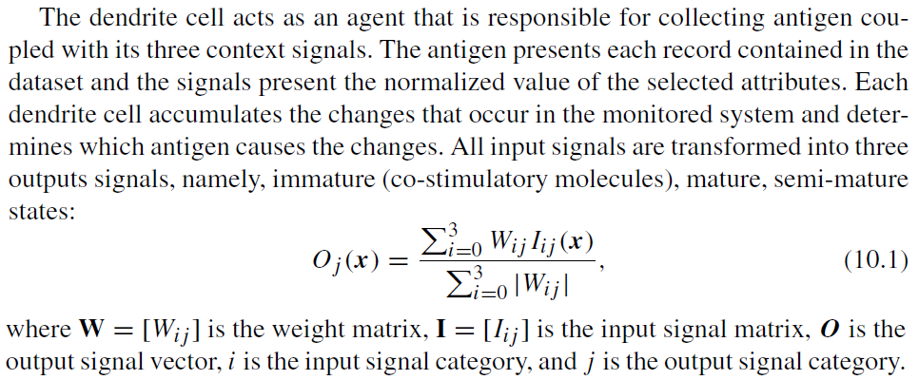

Slide 86
The dendritic cell samples input signals and antigens multiple times, similar to how dendritic cells in the human body hold suspected antigens until maturation. The sampling process increases the cell’s experience, documented in three output signals:
  Immature (O1)
  Mature (O2)
  Semi-mature (O3)

Slide 87
Process:
Sampling continues until O1 reaches the migration threshold, triggering cell migration for antigen presentation.
After migration, O2 and O3 are compared to determine the antigen’s context:
  Mature antigen → If O2 > O3.
  Semi-mature antigen → If O2 < O3.
The migrated dendritic cell is replaced with a new cell, restarting sampling.
This iterative process ensures continuous antigen detection and classification.

Slide 88
Applications:
  Prototype dendritic cell algorithm applied to binary classification, using time stamps as antigens and features forming signal categories.
  Deterministic dendritic cell algorithm removes randomness, providing a more controllable system.

Slide 89
Dendritic Cell Algorithm Tutorial
The Dendritic Cell Algorithm (DCA) is an Artificial Immune System (AIS) inspired by the biological functioning of dendritic cells (DCs) in the human immune system. It's primarily used for anomaly detection and classification, particularly in scenarios involving time-dependent data.

Slide 90
1. Biological Inspiration: Dendritic Cells
To understand the DCA, it's helpful to grasp the biological inspiration:
  Dendritic Cells (DCs): These are "sentinel" cells in the immune system, constantly sampling their environment for signs of danger (pathogens, damaged cells) and safety (normal cellular processes). They act as a bridge between the innate and adaptive immune responses.
  Signal Collection: DCs collect various signals:
    PAMPs (Pathogen-Associated Molecular Patterns): Strong danger signals indicating the presence of pathogens (e.g., bacterial components).
    Danger Signals (DS): Signals released by stressed or damaged cells, indicating abnormal situations.
    Safe Signals (SS): Signals from healthy, normal cells, indicating a safe environment.

Slide 91
  Maturation: Based on the signals they receive, DCs undergo a maturation process:
    Immature DCs (iDCs): Actively sample their environment, collecting antigens and signals.
    Semi-Mature DCs (smDCs): Encounter more safe signals than danger signals. They tend to induce tolerance in T-cells, indicating a normal situation.
    Mature DCs (mDCs): Encounter more danger signals than safe signals. They migrate to lymph nodes and present antigens to T-cells, activating an immune response against potential threats.
  Antigen Presentation: DCs process and present "antigens" (pieces of foreign or abnormal material) to T-cells. The maturation state of the DC determines how the T-cells respond to the presented antigen.

Slide 92
2. Core Concepts of the Dendritic Cell Algorithm
The DCA abstracts these biological processes into a computational model:
  Artificial Dendritic Cells (ADCs): These are the agents in the algorithm, simulating the behavior of biological DCs. A population of ADCs is typically used.
  Input Signals: Data features are mapped to biological signals:
    PAMPs: Represent features that strongly indicate an anomaly.
    Danger Signals (DS): Represent features that suggest an anomaly, but with less certainty than PAMPs.
    Safe Signals (SS): Represent features indicating normal behavior.
  Antigens: The data instances themselves that need to be classified (e.g., network packets, sensor readings).
  Signal Processing: Each ADC processes the input signals over time, accumulating their concentrations. This is often done using weighted sums of the input signals.

Slide 93
  Maturation and Migration: ADCs mature based on the cumulative concentrations of danger and safe signals they've encountered. Once an ADC reaches a certain "lifespan" or "migration threshold" (representing its capacity to collect data or time spent sampling), it "migrates."
  Antigen Classification: When an ADC migrates, it carries the antigen(s) it collected during its lifespan and a "context" value (often represented as a k value) reflecting its maturation state.
    If an ADC migrated as mature (mDC-like), the antigen it presents is likely classified as anomalous.
    If an ADC migrated as semi-mature (smDC-like), the antigen is likely classified as normal.
  Anomaly Detection/Classification: The final classification of an antigen is based on the collective "votes" or context values from multiple migrating ADCs that sampled that antigen.

Slide 94
3. Steps of the Dendritic Cell Algorithm
Here's a general outline of the DCA steps:
  Initialization:
    Define the number of artificial dendritic cells (ADCs) in the population.
    Initialize each ADC with parameters such as:
      Initial lifespan (how much data it can process before migrating).
      Internal signal concentrations (e.g., initial PAMP, Danger, Safe signal levels, and output signals like Costimulatory Molecule (CSM) and k).
      An empty list to store collected antigens.

Slide 95
  Data Preprocessing and Signal Mapping:
    The raw input data needs to be preprocessed. This often involves normalization or scaling.
    Crucially, features in the dataset must be mapped to PAMP, Danger, and Safe signals. This is a critical step and often domain-specific. For example:
      In network intrusion detection, a high rate of failed login attempts could be a PAMP signal, while a high volume of unusual but not necessarily malicious traffic might be a Danger signal. Normal network activity would contribute to Safe signals.
    Each data instance is also identified as an "antigen."

Slide 96
  Signal Processing and Antigen Collection (Iteration Phase):
    The algorithm iterates through the input data instances (antigens) sequentially.
    For each data instance:
      Extract Signals and Antigen: Get the PAMP, Danger, and Safe signal values, and the antigen itself, from the current data instance.
      Assign to ADC (or Sample): The antigen and its associated signals are "exposed" to a subset of ADCs or assigned to a specific ADC based on some strategy (e.g., round-robin, random sampling).

Slide 97
      Update Internal State of ADCs: For the assigned ADC:
        Accumulate Signals: The ADC updates its internal cumulative signal concentrations (PAMP_c, DS_c, SS_c) based on the new input signals.
        Calculate Intermediate Output Signals: Based on these cumulative signals, the ADC calculates intermediate output signals. Common ones include:
          Costimulatory Molecule (CSM): Often a weighted sum of Danger and PAMP signals, or simply the sum of Danger and Safe signals (CSM=DSinput​+SSinput​). This reflects the overall level of stimulation.
          k value (Context Value): This is a critical value that determines the maturation state. A common formula is k=DSinput​−2×SSinput​ or similar, where a positive k indicates a more "dangerous" context (mDC-like) and a negative k indicates a "safe" context (smDC-like).
        Update Lifespan: The ADC's lifespan is typically decremented by its CSM value (or some function of it). This reflects that highly stimulated DCs migrate faster.
        Collect Antigen: The ADC stores the antigen (or a reference to it) it's currently processing.

Slide 98
  Migration and Antigen Presentation:
    When an ADC's lifespan reaches zero (or a predefined migration threshold):
      Migrate: The ADC "migrates" and presents the antigen(s) it collected during its lifetime.
      Determine Maturation State: Based on its final accumulated k value (or other internal metrics), the ADC is classified as either semi-mature or mature. For example, if its cumulative k is above a certain threshold, it's mature; otherwise, it's semi-mature.
      Record Antigen Context: The antigen(s) collected by this migrating ADC are recorded along with the ADC's maturation state (e.g., "Antigen X was presented by a mature DC").
      Reset ADC: The migrated ADC is then "reset" (re-initialized with a new lifespan and cleared internal states) and returned to the pool of active ADCs to continue sampling.

Slide 99
  Analysis and Classification:
    After all data has been processed, or at regular intervals, the collected antigen context information is analyzed.
    Mature Context Antigen Value (MCAV): For each unique antigen type, an MCAV is calculated. This is often the proportion of times that antigen type was presented by a mature DC compared to the total number of times it was presented by any migrating DC. MCAVα​=Total number of times Antigen α was presented by a mature DC/Total number of times Antigen α was presented​
    Classification: A global anomaly threshold is applied to the MCAV values. If the MCAV for an antigen type exceeds this threshold, it is classified as anomalous; otherwise, it is classified as normal.

Slide 100
4. Key Parameters and Considerations
Number of Dendritic Cells: Affects the granularity and coverage of the data sampling.
Signal Weights: The weights used in the weighted sum functions for CSM and k are crucial and often tuned empirically or through optimization algorithms (like Genetic Algorithms).
Maturation Threshold: The threshold for k that distinguishes between semi-mature and mature DCs. This impacts the sensitivity of the algorithm.
Lifespan: The maximum amount of data an ADC processes before migrating.

Slide 101
Antigens Per Cell: The maximum number of antigens an ADC can collect during its lifespan.
Data Preprocessing: Proper normalization and mapping of features to signals are essential for effective performance.
Stochastic vs. Deterministic DCA: Early versions of DCA were quite stochastic. More recent "Deterministic DCA" (dDCA) variants aim for more reproducibility by removing some random elements and streamlining signal processing.

Slide 102
5. Applications
The Dendritic Cell Algorithm has been successfully applied to various anomaly detection and classification problems, particularly in:
  Network Intrusion Detection: Identifying malicious network traffic (e.g., port scans, denial-of-service attacks).
  Fault Detection in Industrial Control Systems: Detecting unusual sensor readings or system behaviors.
  Robotics: For classification tasks where robots need to identify anomalous objects or situations.
  Medical Diagnosis: Potentially in identifying abnormal patterns in medical data.

Slide 103
6. Advantages and Disadvantages
Advantages:
  Bio-inspired: Leverages the robust and adaptive nature of the biological immune system.
  Online/Real-time Processing: Can process data streams and detect anomalies as they occur, without a separate training phase (though parameter tuning often requires an initial dataset).
  Handles Complex and Noisy Data: The population-based approach and signal fusion can provide resilience to noise.
  Adaptability: Can adapt to changing data patterns.

Slide 104
Disadvantages:
  Parameter Tuning: Can be complex and require significant effort to find optimal parameters.
  Interpretability: The "black-box" nature of some internal computations can make it challenging to fully understand why a particular classification was made.
  Computational Cost: Can be computationally intensive, especially with a large number of ADCs and complex signal processing.
  Signal Mapping: The effectiveness heavily relies on how well domain-specific features are mapped to PAMP, Danger, and Safe signals.

Slide 105
This tutorial provides a foundational understanding of the Dendritic Cell Algorithm. For practical implementation, exploring specific deterministic DCA variants and existing codebases can be very beneficial.

Slide 106
Dendritic_Cell_Algorithm.ipynb
dendritic_cell_algorithm.py

