Slide 1
Swarm Intelligence
K.-L. Du and M.N.S. Swamy, Search and Optimization by Metaheuristics, Springer, 20216

Slide 2
Nature-inspired optimization algorithms are broadly categorized into Evolutionary Algorithms (EAs) and Swarm Intelligence (SI) methods:
EAs improve candidate solutions (chromosomes) using evolutionary operators like mutation, crossover, and selection.
Swarm Intelligence methods generate new candidate solutions using differential position update rules.
Swarm Intelligence is popular due to its simplicity, adaptability, and effectiveness in solving complex optimization problems

Slide 3
15.1 Glowworm-Based Optimization
Glowworms and fireflies are bioluminescent beetles that emit light to attract mates or prey. The brightness of their glow is proportional to luciferin levels, influencing interactions within a variable neighborhood.
Most fireflies produce short, rhythmic flashes, with unique patterns for each species. These flashes serve three purposes:
Mating signals—Females respond to the distinct flashing patterns of males from their species.
Prey attraction—Some species use flashing to lure potential prey.
Protective warning—Flashes can deter predators.
Interestingly, some female fireflies mimic the mating signals of other species to deceive and consume male fireflies

Slide 4
15.1.1 Glowworm Swarm Optimization
Glowworm Swarm Optimization (GSO) is inspired by the natural behavior of glowworms, which emit luciferin to attract others. It is designed for simultaneous computation of multiple optima in multimodal functions.

Slide 5
Mechanism:
Glowworms carry luciferin, encoding the fitness of their current location.
Each glowworm identifies neighbors within an adaptive neighborhood, bounded by its sensor range.
Glowworms with higher luciferin emissions are more attractive.
Each agent selects a neighbor with a higher luciferin value and moves toward it using a probabilistic mechanism.

Slide 6
Algorithm Phases:
Luciferin update phase – Glowworms adjust their luciferin levels based on fitness.
Movement phase – Glowworms move toward neighbors with higher luciferin values.
Neighborhood range update phase – The local decision range is adaptively updated.
Through local interactions, the swarm partitions into subgroups, each converging to different optima of the multimodal function

Slide 7
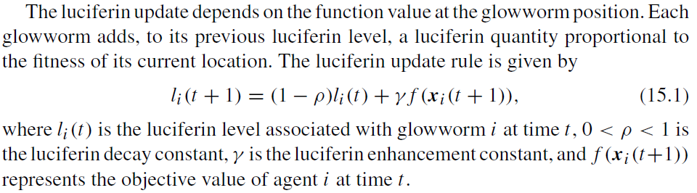

Slide 8
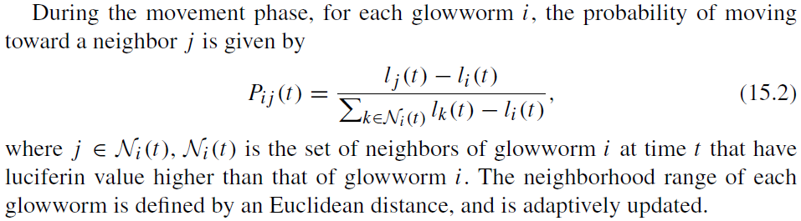

Slide 9
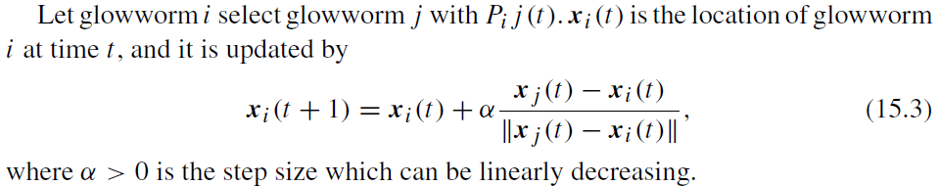

Slide 10
Glowworm Swarm Optimization (GSO) has been applied to multiobjective optimization, particularly in solving the environmental economic dispatch problem. The Technique for Order Preference by Similarity to an Ideal Solution (TOPSIS) is used as a fitness ranking tool to evaluate multiple objectives simultaneously. Additionally, a time-varying step size is incorporated to enhance performance.
GSO's ability to handle multimodal optimization has also been leveraged for big data clustering. In [2], GSO is combined with MapReduce parallelization methodology, improving efficiency and scalability in processing large datasets.

Slide 11
15.1.2 Firefly Algorithm
The Firefly Algorithm (FA) is inspired by fireflies' bioluminescence, which they use to attract mates and prey. Originally proposed for multimodal continuous optimization, it has been extended to constrained optimization and discrete optimization, such as flowshop scheduling to minimize makespan.

Slide 12
Mechanism:
Fireflies are attracted to others based on brightness, which represents solution quality.
Attractiveness decreases as distance increases.
If a firefly finds no brighter neighbor, it moves randomly.
Brightness is influenced by the objective function landscape, guiding the search process.
FA shares similarities with Particle Swarm Optimization (PSO) but follows light-based attraction dynamics rather than velocity-based movement.

Slide 13
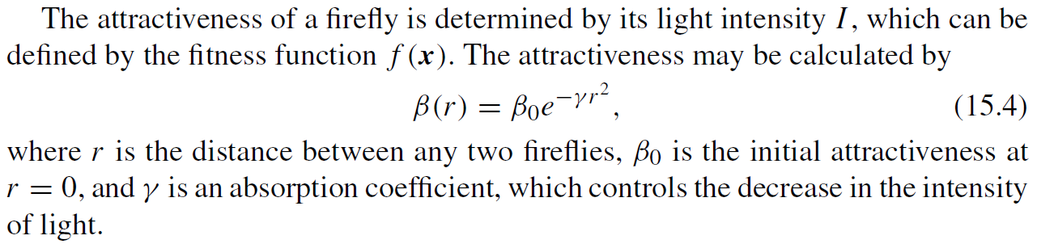

Slide 14
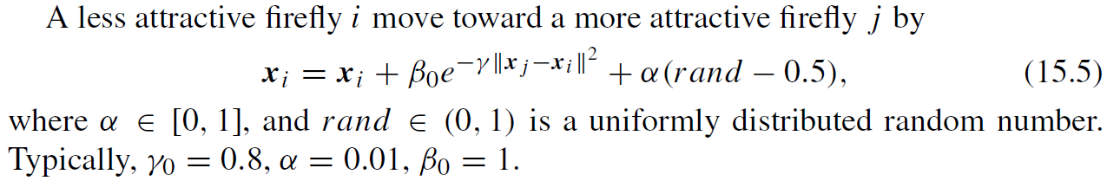

Slide 15
The Firefly Algorithm (FA) operates by moving fireflies toward brighter ones based on light intensity. If firefly j has lower intensity than firefly i, it moves toward i, updating attractiveness and light intensity. The process repeats until the termination criterion is met.

Slide 16
Limitations & Enhancements:
FA is influenced by local optima, limiting exploration and global search capability.
Fuzzy Firefly Algorithm improves exploration by incorporating global optima and brighter fireflies into movement decisions. Attractiveness is treated as a fuzzy variable, enhancing adaptability.
Eagle Strategy is a two-stage hybrid search method combining Levy walk (random search) with FA, improving stochastic optimization.

Slide 17
15.2 Group Search Optimization
Group Search Optimization (GSO) is a swarm intelligence algorithm inspired by animal search behavior and group living theory. It follows the producer–scrounger model, where producers scan for resources, scroungers follow the producer, and dispersed members (rangers) perform random walks to escape local minima.

Slide 18
Mechanism:
Producer: Scans three points (front, left, right) and moves to the best position if improvement is found.
Scroungers: Move randomly toward the producer, joining discovered resources.
Rangers: Turn to a random angle and explore new search directions.
Best-positioned member becomes the producer at each iteration.

Slide 19
Enhancements & Applications:
Small-world topology improves scrounger diversity, allowing efficient information spread in the swarm.
Area-restricted search behavior inspired the Synthetic Predator Search Algorithm for combinatorial optimization problems.

Slide 20
15.3 Shuffled Frog Leaping
Shuffled Frog Leaping Algorithm (SFLA) is a memetic metaheuristic inspired by frogs searching for food in a swamp. It combines elements of memetic algorithms, Particle Swarm Optimization (PSO), and parallel local search. SFLA has been applied to discrete and continuous optimization problems, performing similarly to PSO and outperforming Genetic Algorithms (GA).

Slide 21
Mechanism:
Frogs with worst positions leap toward better positions by sharing ideas with local/global best frogs.
Local evolution occurs through social interaction within memeplexes (subgroups).
Global evolution is achieved by shuffling the population after each generation.

Slide 22
Algorithm Stages:
Partitioning – The population is divided into memeplexes, each representing a frog culture.
Local search – Frogs optimize their positions by improving the worst frog’s movement using PSO-like adaptation.
Shuffling – Ideas are exchanged among memeplexes, ensuring global convergence.

Slide 23
Enhancements & Variants:
Modified SFLA introduces an inertia component to improve worst frog movement.
Shuffled Differential Evolution (Shuffled DE) integrates partitioning and shuffling concepts from SFLA into Differential Evolution (DE).

Slide 24
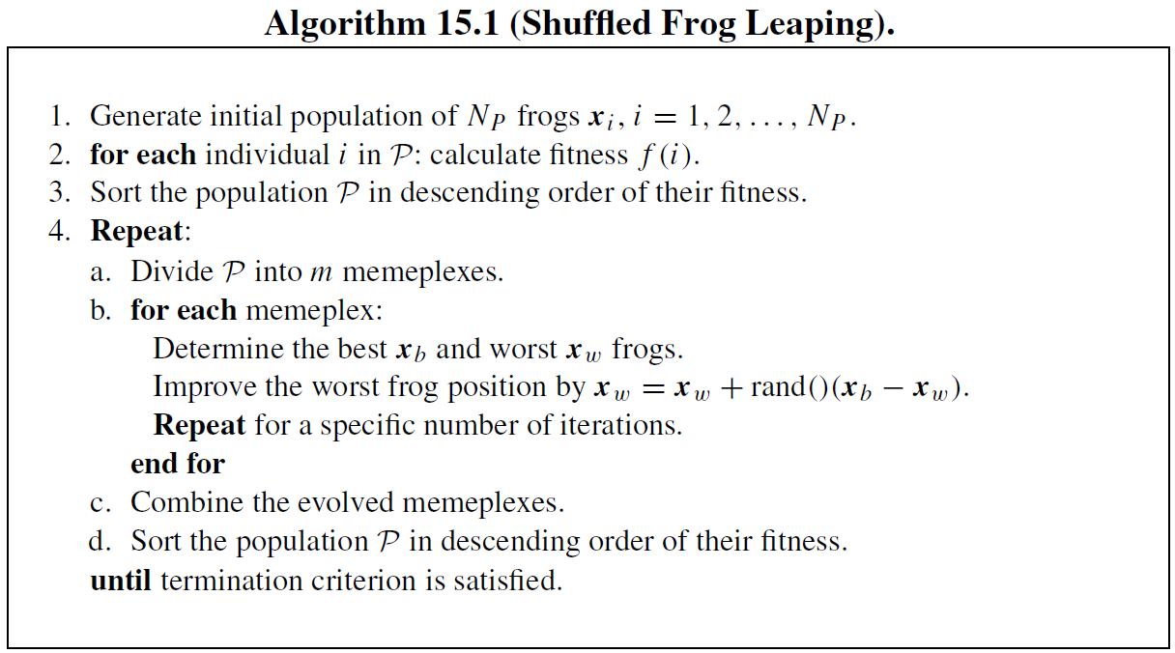

Slide 25
Jumping Frogs Optimization (JFO) is a metaheuristic optimization method inspired by frog jumping, designed for discrete problems. It is similar to Particle Swarm Optimization (PSO) but does not use velocity or inertia. Instead, it retains the notion of attraction to leaders and incorporates random jumps in particle movement.

Slide 26
Mechanism:
Particles move randomly or toward attractors (leaders).
Local search is applied after each movement to refine solutions.
The swarm evolves by continuously improving particle positions through random jumps and local search.
JFO enhances solution quality by combining random exploration with systematic refinement, making it effective for discrete optimization problems

Slide 27
15.4 Collective Animal Search
Collective Animal Behavior Algorithm (CABA) is a metaheuristic optimization method inspired by collective animal behavior, designed for multimodal optimization. Searcher agents represent animals, interacting based on biological laws of collective motion through simple behavioral rules.

Slide 28
Mechanism:
Memory system stores:
Mg → Best positions in the current generation.
Mh → Best positions in the entire evolutionary process.
Random solutions (animal positions) are initially generated.
Fitness value represents animal dominance within the group.
Movement dynamics:
Local attraction & repulsion → Individuals move toward or away from neighbors.
Random movement → Some individuals explore new areas.
Competition for space → Positions are updated in memory.
The process repeats until the termination criterion is met, ensuring efficient exploration and optimization.

Slide 29
Free Search Algorithm (FSA)
Inspired by animal behavior, Free Search operates on a population of solutions, where each animal has two key attributes:
Sense → Determines orientation within the search space and selects next locations based on pheromone markings.
Mobility → Controls step size, allowing small steps for local search and large steps for global exploration.

Slide 30
Mechanism:
Animals explore the neighbor space, ensuring nonzero probability of accessing any location.
Objective function value determines pheromone distribution, influencing future movements.
Pheromone is replaced after each exploration walk.
Animals independently decide their search strategy, balancing local refinement and global exploration.

Slide 31
Animal Migration Optimization (AMO)
Inspired by animal migration, AMO simulates:
Group movement → Animals move from current to new positions, following three main rules.
Group dynamics → Some animals leave, while others join, ensuring adaptive population changes.
Both algorithms leverage biological movement patterns to enhance optimization efficiency.

Slide 32
15.5 Cuckoo Search
Inspired by cuckoo birds' brood parasitism, Cuckoo Search is a metaheuristic algorithm for global optimization, incorporating Levy flight behavior.
Biological Inspiration:
Cuckoos lay eggs in randomly chosen nests.
Host birds may reject foreign eggs, either discarding them or abandoning the nest.
Some cuckoo species mimic host eggs, reducing rejection probability.
Cuckoo chicks hatch earlier, often evicting host eggs and mimicking host chick calls for feeding.

Slide 33
Algorithm Rules:
Each cuckoo lays one egg (new solution) in a random nest.
Best nests (high-quality solutions) carry over to the next generation.
Host birds discover foreign eggs with probability Pa ∈ [0,1]. Discovered nests are abandoned and replaced with new random solutions.

Slide 34
Levy Flights Algorithm:
Stochastic global optimization method based on random walks.
Levy distribution differs from Gaussian and Cauchy distributions, having infinite variance and mean.
Many birds and insects exhibit Levy flight behavior in foraging, where movement depends on current state and probability variations.
Both algorithms leverage natural movement patterns for efficient exploration and optimization.

Slide 35
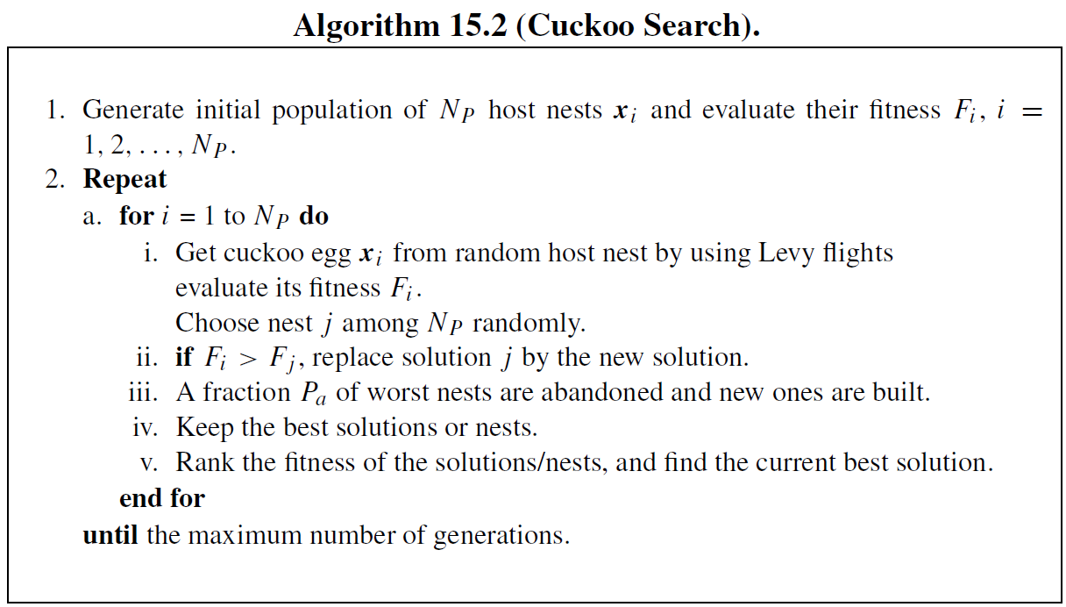

Slide 36
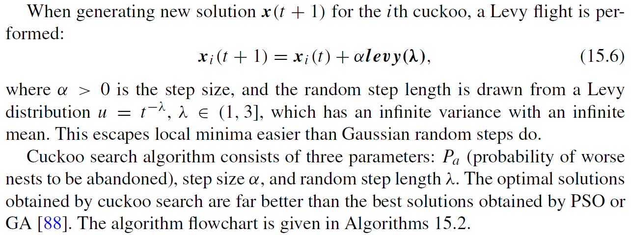

Slide 37
CSA consists of three key parameters:
Pa → Probability of worse nests being abandoned.
Step size (α) → Controls solution movement.
Random step length (λ) → Influences exploration range.
CSA outperforms PSO and GA in finding optimal solutions.

Slide 38
Enhancements & Variants:
Multimodal optimization enhancement ([19]):
Memory mechanism stores potential local optima based on fitness and distance.
Modified selection strategy accelerates local minima detection.
Depuration procedure eliminates duplicate memory elements cyclically.
Cuckoo Optimization Algorithm (COA) ([66]):
Inspired by cuckoo survival competition through egg-laying and breeding.
Mature cuckoos lay eggs in host nests; unrecognized eggs grow into new cuckoos.
Survival competition leads to cuckoo societies migrating to better environments.
Eventually, one dominant cuckoo society remains, converging to the best breeding environment.
Modified COA ([49]): Adapted for discrete optimization problems, improving applicability.
These adaptations enhance search efficiency, solution diversity, and convergence speed.

Slide 39
15.6 Bat Algorithm
Inspired by bat echolocation, BA is a metaheuristic optimization method where bats use biosonar to sense distance, detect surroundings, and navigate.
Biological Inspiration:
Bats emit ultrasonic pulses (up to 110 dB) and analyze echoes to hunt prey and avoid obstacles.
Pulse rate increases and loudness decreases as bats approach prey.
Echolocation also serves as a communication mechanism in bat populations.

Slide 40
Algorithm Mechanism:
Bats fly randomly with velocity ( v_i ) at position ( x_i ), using:
Fixed frequency ( f_{\text{min}} )
Varying wavelength ( \lambda )
Loudness ( A_0 )
Pulse rate ( r \in [0,1] ) increases and loudness ( A ) decreases as bats approach local optima.
Control parameters:
Pulse rate ( r ) → Improves best solution.
Loudness ( A ) → Influences solution acceptance.

Slide 41
Algorithm Steps:
Initialization → Set parameters and generate random initial population.
Solution evaluation → Determine best solution ( x_{\text{best}} ).
Variation operation → Move bats in search space.
Local search → Improve current best solution using random walk heuristics.
Replacement step → Replace current solution with new solution based on pulse rate ( r ) and loudness ( A ).

Slide 42
Comparison with PSO:
BA controls movement speed by adjusting frequency, whereas PSO relies on velocity updates.
BA balances local/global search using pulse rate and loudness, making PSO a special case of BA.
BA effectively balances exploration and exploitation, making it highly efficient for global optimization.

Slide 43
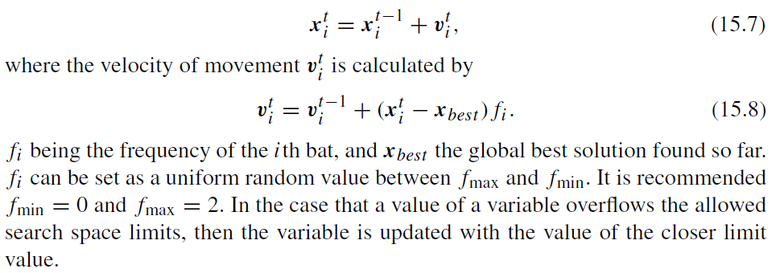

Slide 44
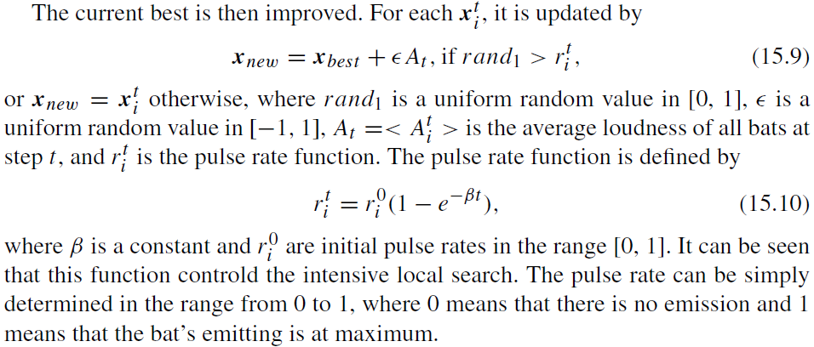

Slide 45
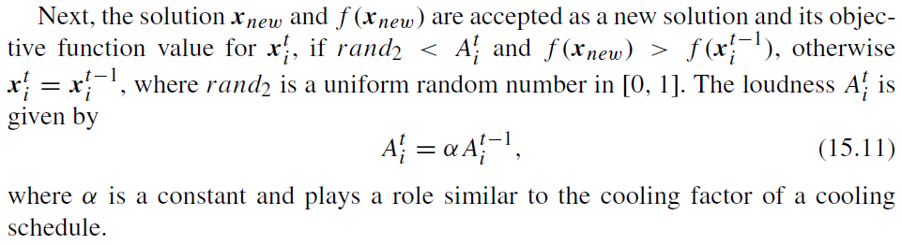

Slide 46
Discrete Bat Algorithm (DBA) Applications:
Flowshop Scheduling Problem → DBA has been applied to optimal permutation flowshop scheduling ([46]).
Traveling Salesman Problem (TSP) → DBA has been adapted for both symmetric and asymmetric TSPs ([60]).

Slide 47
Chaotic-Based Bat Swarm Optimization ([32]):
Incorporates chaotic strategies to enhance diversity in bat movements.
Ergodicity and non-repetitious nature of chaotic functions prevent premature convergence.
Loudness adjustment → Computed by multiplying a linearly decreasing function with a chaotic map function, ensuring dynamic adaptation.
These enhancements improve exploration capability, making BA more effective for complex optimization problems.

Slide 48
15.7 Swarm Intelligence Inspired by Animal Behaviors

Slide 49
15.7.1 Social Spider Optimization
The Social Spider Algorithm (SSA) is a swarm intelligence optimization method inspired by the mating and foraging behaviors of social spiders. Social spiders interact through vibrations transmitted across their shared web, allowing them to detect prey and coordinate movement.

Slide 50
In SSA:
The search space is modeled as a hyper-dimensional spider web, where each position represents a potential solution.
Spiders (agents) move freely, generating vibrations that propagate across the web.
The intensity of vibrations corresponds to the fitness of a solution, enabling information sharing and collective decision-making.
The algorithm incorporates gender-based behaviors, where different evolutionary operators guide male and female spiders in distinct ways.
SSA effectively solves global optimization problems by mimicking the information-sharing foraging strategy of social spiders, leveraging vibrations to refine solutions collaboratively.

Slide 51
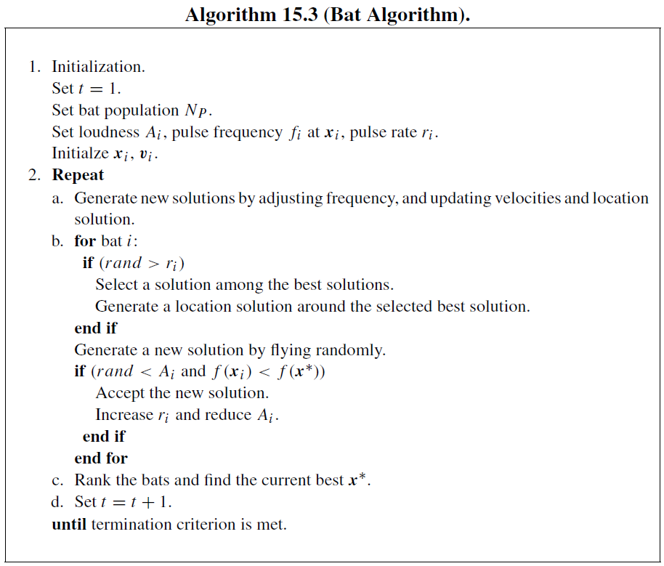

Slide 52
15.7.2 Fish Swarm Optimization
Artificial Fish Swarm Optimization (AFSO) is a population-based optimization technique inspired by the collective movement and social behaviors of fish. It shares similarities with Particle Swarm Optimization (PSO) and relies on instinctive behaviors to maintain the swarm.

Slide 53
Key Features of AFSO:
Local Search & Greedy Selection: A fish moves to a new position only if it improves the solution.
Environmental Influence: Each fish’s behavior depends on its current state and the surrounding environment.
High Convergence Speed: The algorithm quickly finds solutions but may fall into local optima and has high time complexity.

Slide 54
Search Behaviors in AFSO:
Prey Behavior – Searching for food (better solutions).
Swarm & Follow Behaviors – Seeking food or companions in larger areas.
Move Behavior – Adjusting position based on local conditions.
Leap Behavior – Escaping local optima by jumping to new states.

Slide 55
Variants & Improvements:
Improved AFSO: Uses a log-linear model for adaptive behavior selection, enhancing decision-making.
Population Inhibition & Expansion: Large fish consume small fish to accelerate convergence, followed by diversity restoration.
Fish School Search (FSS): A swarm-based metaheuristic with feeding, swimming, and breeding operators, balancing exploration and exploitation.
FSS-II: An improved version with higher exploitation capability and reduced fitness evaluations per iteration.
AFSO and its variants are effective for high-dimensional multimodal optimization problems, leveraging biologically inspired behaviors to refine solutions dynamically.

Slide 56
15.7.3 Krill Herd Algorithm
The Krill Herd Algorithm (KHA) is a metaheuristic swarm intelligence optimization method inspired by the herding behavior of krill swarms in response to biological and environmental factors.
Key Mechanisms in KHA:
Motion Induced by Other Individuals – Krill adjust their movement based on interactions with nearby swarm members.
Foraging Motion – Krill navigate using food location and past experiences to optimize their search.
Physical Diffusion – A random movement process that introduces exploration diversity.

Slide 57
Advantages of KHA:
Simple Parameter Tuning: Only the time interval needs fine-tuning, making it more straightforward than other nature-inspired algorithms.
Balanced Exploration & Exploitation: The combination of social interaction, memory-based foraging, and random diffusion allows for effective optimization.
KHA is particularly useful for global optimization problems, leveraging biologically inspired movement strategies to refine solutions dynamically.

Slide 58
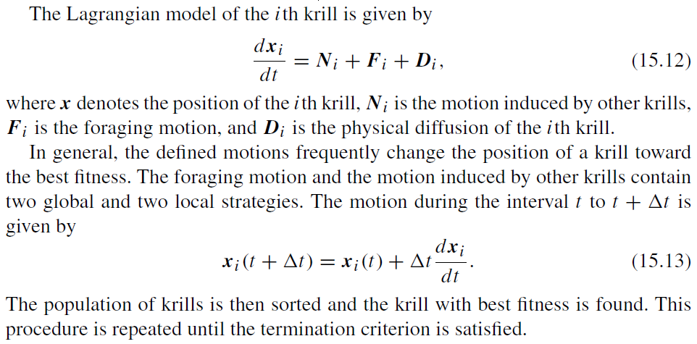

Slide 59
The Stud Krill Herd Algorithm (SKHA) enhances the Krill Herd Algorithm (KHA) by incorporating stud selection and crossover operators during the krill updating process. Instead of stochastic selection, the best krill (stud) shares optimal information with the population using genetic operators, improving convergence.

Slide 60
Variants of Krill Herd Algorithm:
Discrete Krill Herd Algorithm – Adapted for network route optimization, applying discrete optimization techniques.
Free Search Krill Herd Algorithm (FSKHA) – Introduces:
Opposition-based learning for generating more uniform initial populations.
Free search operator to simulate uncertain individual behavior, allowing krill to move freely based on their own perception.
Sensitivity adjustment, where:
Higher sensitivity moves krill toward the global best.
Lower sensitivity encourages local exploration.

Slide 61
Advantages of Free Search Krill Herd Algorithm:
Avoids local optima by allowing krill to explore the entire search space with nonzero probability.
Improves optimization performance, outperforming PSO, DE, KHA, Harmony Search, Free Search, and Bat Algorithm.
These enhancements make FSKHA a powerful optimization method, balancing exploration and exploitation while maintaining adaptive search behavior.

Slide 62
15.7.4 Cockroach-Based Optimization
Roach Infestation Optimization (RIO) is a metaheuristic optimization method inspired by the social behavior of cockroaches, particularly their tendency to seek dark shelters while maintaining social connections. It improves upon Particle Swarm Optimization (PSO) by modifying key mechanisms.
Key Features of RIO:
Shelter-Seeking Behavior: Unlike PSO, where particles gather around food sources, cockroaches congregate under dark shelters.
Local Best Positions: RIO replaces PSO’s global best position with local best positions, enhancing adaptability.
Random Search Behavior: Introduced to prevent convergence on local minima, improving global optimization.

Slide 63
Hungry Behavior in RIO:
At intervals, hungry cockroaches leave their comfortable shelters and social groups to search for food, adding dynamic exploration.
Hungry PSO & Hungry RIO extend this concept to PSO and RIO, increasing search diversity.
Advantages of RIO Over PSO:
Better global optimization due to local best selection and random search.
Avoids premature convergence by incorporating hunger-driven exploration.
RIO provides a robust optimization framework, balancing social clustering and adaptive exploration, making it more effective than PSO in finding global optima.

Slide 64
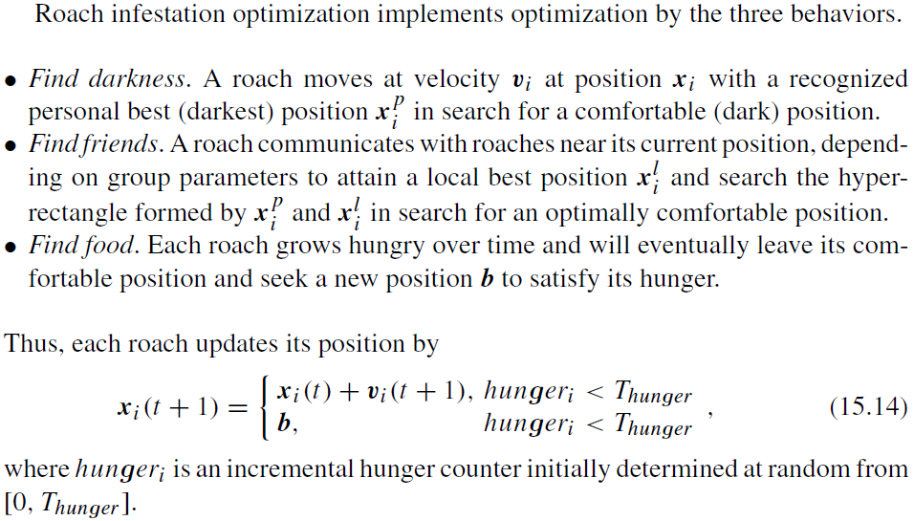

Slide 65
Cockroach Swarm Optimization (CSO) is a metaheuristic optimization algorithm that mimics the chase-swarming, dispersion, and ruthless social behaviors of cockroaches. It shares similarities with Particle Swarm Optimization (PSO) but incorporates additional behaviors to enhance search efficiency.

Slide 66
Key Behaviors in CSO:
Chase-Swarming Behavior – Cockroaches are attracted to their personal best within their visual range or the global best.
Dispersion Behavior – Introduces random movement to increase exploration.
Ruthless Behavior – Forces an individual to move directly to the global best position, accelerating convergence.
Hunger Behavior – Modeled using a partial differential equation:- A hunger threshold is defined.
When a cockroach reaches this threshold, it migrates to a food source within the search space.

Slide 67
Advantages of CSO:
Improved exploration and exploitation through diverse behavioral mechanisms.
Prevents local optima by incorporating hunger-driven migration.
Outperforms Roach Infestation Optimization (RIO) and Hungry RIO, offering better global optimization performance.
CSO provides a powerful optimization framework, balancing adaptive movement, social interactions, and hunger-driven exploration, making it highly effective for complex search problems.

Slide 68
15.7.5 Seven-Spot Ladybird Optimization
Seven-Spot Ladybird Optimization (SSLO) is a metaheuristic algorithm inspired by the foraging behavior of the seven-spot ladybird (Coccinella septempunctata). It shares similarities with Particle Swarm Optimization (PSO) by utilizing local best (lbest) and global best (gbest) positions for search.

Slide 69
Key Search Mechanisms in SSLO:
Intensive Search – Slow movement within aphid aggregates, focusing on local optimization.
Extensive Search – Faster, linear movement between aphid aggregates within a patch, improving exploration.
Dispersal – Movement between patches, expanding the search space.
Migration – Transition from patches to hibernation, ensuring adaptability.

Slide 70
Ladybird’s Foraging Behavior:
Uses antennae and maxillary palpi to detect prey.
Sideward vibrations of maxillary palpi increase the search area, enhancing prey detection.

Slide 71
Advantages of SSLO:
Adaptive search strategy, switching between intensive and extensive modes.
Efficient exploration and exploitation, balancing local refinement and global search.
Biologically inspired movement patterns improve optimization performance.
SSLO provides a structured and dynamic approach to optimization, leveraging natural foraging behaviors to refine solutions effectively

Slide 72
15.7.6 Monkey-Inspired Optimization
Monkey Search (MS)
Metaheuristic optimization algorithm inspired by monkeys climbing trees for food.
Tree branches represent perturbations between neighboring feasible solutions.
The monkey marks and updates branches leading to better solutions as it climbs.
Various perturbation strategies can be applied, integrating techniques from other metaheuristics for global optimization.

Slide 73
Spider Monkey Optimization (SMO)
Numerical optimization approach inspired by fission–fusion social structures in animals like spider monkeys.
Groups split into smaller subgroups when food is scarce and merge back when food is abundant.
This adaptive grouping behavior enhances exploration and exploitation, making SMO effective for dynamic optimization problems.

Slide 74
Monkey King Evolutionary Algorithm (Monkey King EA)
Memetic evolutionary algorithm (EA) designed for global optimization.
Outperforms PSO variants in robustness, optimization accuracy, and convergence speed.
Demonstrates superior performance on BBOB and CEC benchmark functions, making it a strong competitor in evolutionary computation.
These monkey-inspired algorithms leverage adaptive movement, social intelligence, and evolutionary strategies to enhance optimization efficiency across various problem domains.

Slide 75
15.7.7 Migrating-Based Algorithms
Self-Organizing Migrating Algorithm (SOMA)
Stochastic population-based optimization algorithm inspired by cooperating individuals.
Operates in migration loops, where:
The population is randomly distributed at the start.
The individual with the highest fitness becomes the leader (L).
All other individuals move toward the leader in each loop.
Mutation ensures diversity, restoring lost information.
Perturbation (PRT) vector controls movement, using a binary perturbation vector to define allowed dimensions.
Converges toward the global optimum through structured migration and adaptation.

Slide 76
Differential Search Algorithm (DSA)
Metaheuristic search technique mimicking migration behavior of living organisms.
Individuals move away from low-food habitats toward more fruitful environments.
Migration follows a Brownian-like random walk of a superorganism.
The superorganism settles at stopover sites temporarily before continuing migration.
Unique mutation and crossover operators refine solutions.
Uses only two control parameters, making it efficient and adaptable.

Slide 77
Key Advantages of These Algorithms:
SOMA: Structured leader-based migration, ensuring gradual convergence.
DSA: Brownian motion-inspired migration, allowing dynamic exploration.
Both methods balance exploration and exploitation, making them effective for global optimization problems.

Slide 78
15.7.8 Other Methods
Society and Civilization Algorithm (SCA)
Stochastic optimization method designed for single-objective constrained problems.
Inspired by intra- and inter-society interactions in human and social insect societies.

Slide 79
Gray Wolf Optimizer (GWO)
Mimics the leadership hierarchy and hunting mechanism of gray wolves (Canis lupus).
Uses four types of wolves to simulate leadership.
Implements three hunting steps: searching, encircling, and attacking prey.
Competitive with Gravitational Search Algorithm (GSA) and Differential Evolution (DE).

Slide 80
Dog Group Wild Chase and Hunt Drive Algorithm
Metaheuristic inspired by dogs hunting in groups, simulating intelligent chasing and hunting strategies.
Bird Mating Optimizer (BMO)
Inspired by bird species evolution and intelligent mating behavior during breeding seasons.
Raven Roosting Optimization (RRO)
Based on social roosting and foraging behavior of common ravens.
Roosts serve as information centers, spreading knowledge about food locations.

Slide 81
6. Dolphin Partner Optimization (DPO)
Inspired by dolphin clustering behavior, predicting optimal positions based on team members’ fitness.
7. Dolphin Echolocation Optimization (DEO)
Mimics dolphins’ biological sonar (echolocation) for navigation and hunting.
Few parameters to set, making it efficient.
8. Fish Electrolocation Optimization (FEO)
Inspired by electrolocation, a technique used by elephant nose fish and sharks to detect prey.
Combines active and passive electrolocation for enhanced optimization.

Slide 82
Fruit Fly Optimization Algorithm (FFOA)
Swarm-based optimization inspired by fruit fly foraging behavior.
Normal cloud model improves convergence and global search ability.
Bimodal Adaptive FFOA divides the population into:
Search group (olfactory sensors for global search).
Capture group (vision-based local exploitation).
Outperforms or matches PSO and DE.

Slide 83
Antlion Optimizer (ALO)
Population-based global optimization mimicking antlion hunting strategies.
Implements five hunting steps:- Random walk, trap building, entrapment, catching prey, and trap rebuilding.
Moth Flame Optimization (MFO)
Inspired by moths’ transverse orientation, where they maintain a fixed angle with the moon for navigation.
Simulates moths’ spiral movement around artificial lights, adapting it for optimization.

Slide 84
Key Takeaways:
These algorithms leverage biological behaviors for global optimization.
Many improve upon PSO and DE, offering better exploration and exploitation balance.
Adaptive strategies like social interactions, hunting mechanisms, and sensory-based navigation enhance optimization efficiency.

